Slide 1
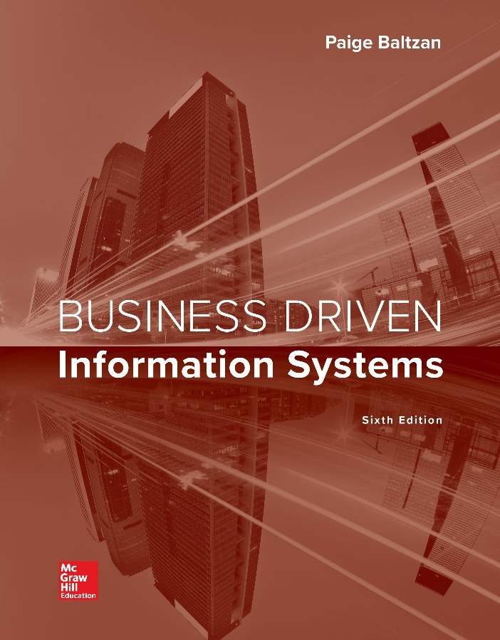
CHAPTER EIGHT
Enterprise Applications:
Business Communications
哈雷摩托車公司的最大資產之一是其忠誠的客戶。在經歷了20世紀60年代和70年代的日本競爭之後，該公司在1981年渡過難關，當時有13名高階主管購買了該公司。領導人比爾斯在密爾沃基總部中慶祝。新業主決定成立Harley Owners Group（H.O.G），讓客戶更多地參與該產品。 通過HOG以其忠誠的客戶群和公司內部的員工在公司外開了一個對話。
1993年，在HOG開始後的10多年裡，該公司慶祝其成立90週年，超過10萬名HOG成員聚集在密爾沃基，參加了6萬台Harley-Davidson機器的駕車遊行。
Notes:
CLASSROOM OPENER
GREAT BUSINESS DECISIONS – Harley-Davidson Begins the Harley Owners Group (H.O.G.) to Encourage Customer Involvement
One of the biggest assets for Milwaukee-based Harley-Davidson Motorcycle Company is its intensely loyal customers. After struggling against Japanese competition throughout the 1960s and 1970s, the company turned a corner in 1981 when a group of 13 senior Harley-Davidson executives purchased the company. Vaughn Beals, the leader, celebrated with a victory ride from the company’s factory in York, Pennsylvania, to its headquarters in Milwaukee. The new owners decided to begin the Harley Owners Group (H.O.G) to get customers more involved with the product. HOG worked. With HOG, the company was able to key into its greatest asset, the people who care about the Harley-Davidson company. HOG opened a dialog outside the company with its loyal customer base and inside the company with its workforce.
In 1993, a little over 10 years after the start of HOG, the company celebrated its 90th anniversary with more than 100,000 HOG members converging on Milwaukee for a drive-through parade featuring 60,000 Harley-Davidson machines.

Slide 2
Chapter Eight Overview
SECTION 8.1 – Enterprise Systems and Supply Chain Management
Building a Connected Corporation Through Integrations
Supply Chain Management
Technologies Reinventing the Supply Chain
SECTION 8.2 – Customer Relationship Management and Enterprise Resource Planning
Customer Relationship Management
The Benefits of CRM
Enterprise Resource Planning
Organizational Integration with ERP
Notes:
Companies that excel in supply chain operations perform better in almost every financial measure of success, according to a report from Boston-based AMR Research Inc. When supply chain excellence improves operations, companies experience a 5 percent higher profit margin, 15 percent less inventory, 17 percent stronger “perfect order” ratings, and 35 percent shorter cycle times than their competitors.
“The basis of competition for winning companies in today’s economy is supply chain superiority,” said Kevin O’Marah, vice president of research at AMR Research. “These companies understand that value chain performance translates to productivity and market-share leadership. They also understand that supply chain leadership means more than just low costs and efficiency: It requires a superior ability to shape and respond to shifts in demand with innovative products and services.”

Slide 3
Section 8.1
SUPPLY CHAIN MANAGEMENT
Notes:
This chapter takes a look at extending an organization through SCM and discusses:
The reasons for SCM’s explosive growth
Using SCM to enhance decision making
SCM success factors
Traditional SCM thinking involved “I buy from my suppliers, I sell to my customers.”
Today, organizations are quickly realizing the tremendous value they can gain from having visibility throughout their supply chain
Knowing immediately what is transacting at the customer end of the supply chain, instead of waiting days or weeks for this information to flow upstream, allows the organization to react immediately
Best Buy checks inventory levels at each of its 750 stores across North America as often as every half-hour

Slide 4
Learning Outcomes 1 of 2
8.1 Explain integrations and the role they play in connecting a corporation.
8.2 Describe supply chain management along with its impact on business.
8.3 Identify the three technologies that are reinventing the supply chain.

Slide 5
Building a Connected Corporation Through Integrations
Integration – Allows separate systems to communicate directly with each other, eliminating the need for manual entry into multiple systems
Application integration: integration of a company’s existing management information systems
Data integration
Forward integration: sends information entered into a given system automatically to all downstream systems and processes
Backward integration: sends information entered into a given system automatically to all upstream systems and processes
Notes:
Eintegration: use of the Internet to provide customers with the ability to gain personalized information by querying corporate databases and their information sources.
Application integration: integration of a company’s existing management information systems.
Data integration: integration of data from multiple sources, which provides a unified view of all data
Forward integration: sends information entered into a given system automatically to all downstream systems and processes.
Backward integration: sends information entered into a given system automatically to all upstream systems and processes
One of the biggest benefits of integration is that organizations only have to enter information into the systems once and it is automatically sent to all of the other systems throughout the organization
This feature alone creates huge advantages for organizations because it reduces information redundancy and ensures accuracy and completeness
Without integrations an organization would have to enter information into every single system that requires the information from marketing and sales to billing and customer service
For example, customer information would have to be manually entered into the marketing, sales, ordering, inventory, billing, and shipping databases. (Each of these systems are separate and would have their own database, if the company doesn’t have a complete ERP installed.)
Entering the same customer information into multiple systems is redundant, and chances of making a mistake in one of the systems is high
Integrations offer many advantages, but for the most part, the automated flow of information among separate systems is the biggest benefit

Slide 6
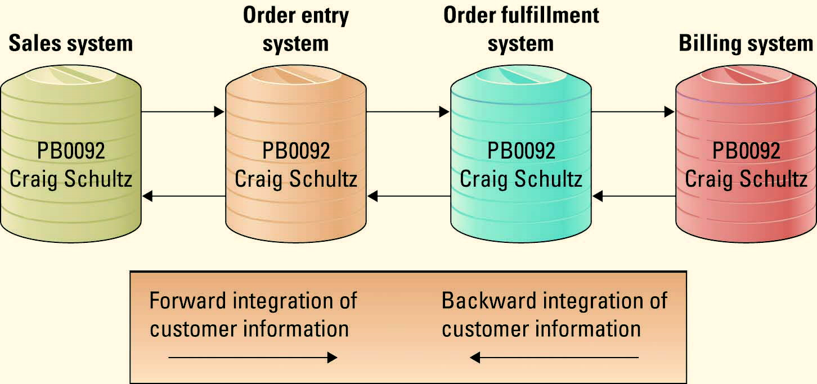
Figure 8.2 A Forward and Backward Customer Information Integration Example
Jump to long image description
Notes:
Identify the arrows along the top of the figure when explaining forward integrations
Basically, all information flows forward along the business process
Sales enters the information when it is negotiating the sale (looking for opportunities)
The information is then passed to the order entry system when the order is actually placed
The order fulfillment system picks the products from the warehouse, packs the products, labels boxes, etc
Once the order is filled and shipped, the customer is billed
What would happen if users could enter order information directly into the billing system?
The systems would quickly become out-of-sync. There might be bills for nonexistent orders, or orders that do not have any bills (if someone deleted a bill)
For this reason organizations typically place a business-critical integrity constraint on integrated systems: With a forward integration the information must be entered in the sales system, you could not enter information directly into the billing system
Integrations are expensive to build and maintain
Integrations are difficult to implement
For these reasons many organizations only build forward integrations and use business-critical integrity constraints to ensure all information is always entered only at the start of the integration (one source of record)
Identify the arrows along the bottom of the figure when explaining backward integrations
Basically, all information flows backward along the business process
Billing enters information and this information is passed back to the order system
The order fulfillment system passes the information back to the order entry system
The order entry system passes the information back to the sales system
Why would an organization want to build both forward and backward integrations?
This allows users to enter information at any point in the business process and the information is automatically sent upstream and downstream to all other systems
For example, if order fulfillment determined that they could not fulfill an order (the product had been discontinued), they could simply enter this information into the database and it would be sent automatically upstream to the sales representative who could contact the customer and downstream to billing to remove the item from the bill

Slide 7
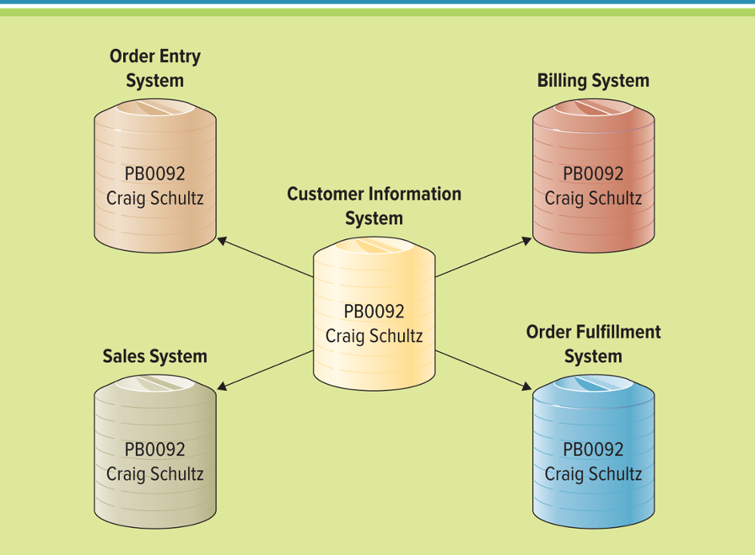
Figure 8.3 Integrating Customer Information Among Databases
A Central Information Repository Example
Jump to long image description
Notes:
The above figure displays an example of customer information integrated using this method
Users can create, read, update, and delete in the main customer repository, and it is automatically sent to all of the other databases
This method does not follow the business process when building the integrations
Business-critical integrity constraints still need to be built to ensure information is only ever entered into the customer repository, otherwise the information will become out-of-sync

Slide 8
Integration Tools 1 of 2
Enterprise system – Provide enterprise-wide support and data access for a firm’s operations and business processes
Enterprise application integration (EAI) – Connects the plans, methods, and tools aimed at integrating separate enterprise systems
Notes:
Enterprise systems can manage information across the entire enterprise allowing users to view every detail of business operations
Enterprise systems are often available as a generic, but highly customizable, group of programs for business functions such as accounting, manufacturing, and marketing

Slide 9
Integration Tools 2 of 2
Middleware – Several different types of software that sit between and provide connectivity for two or more software applications
Enterprise application integration middleware – Takes a new approach to middleware by packaging commonly used applications together, reducing the time needed to integrate applications from multiple vendors
Notes:
Integrations are achieved by using middleware
Middleware translates information between disparate systems

Slide 10
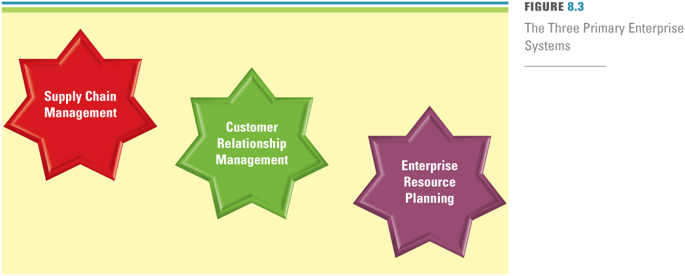
Figure 8.4 The Three Primary Enterprise Systems
Notes:
The remainder of this chapter focuses on the three primary enterprise systems
Supply chain management
Customer relationship management
Enterprise resource planning
It concludes with how you can build a connected corporation by integrating SCM, CRM, and ERP systems.

Slide 11
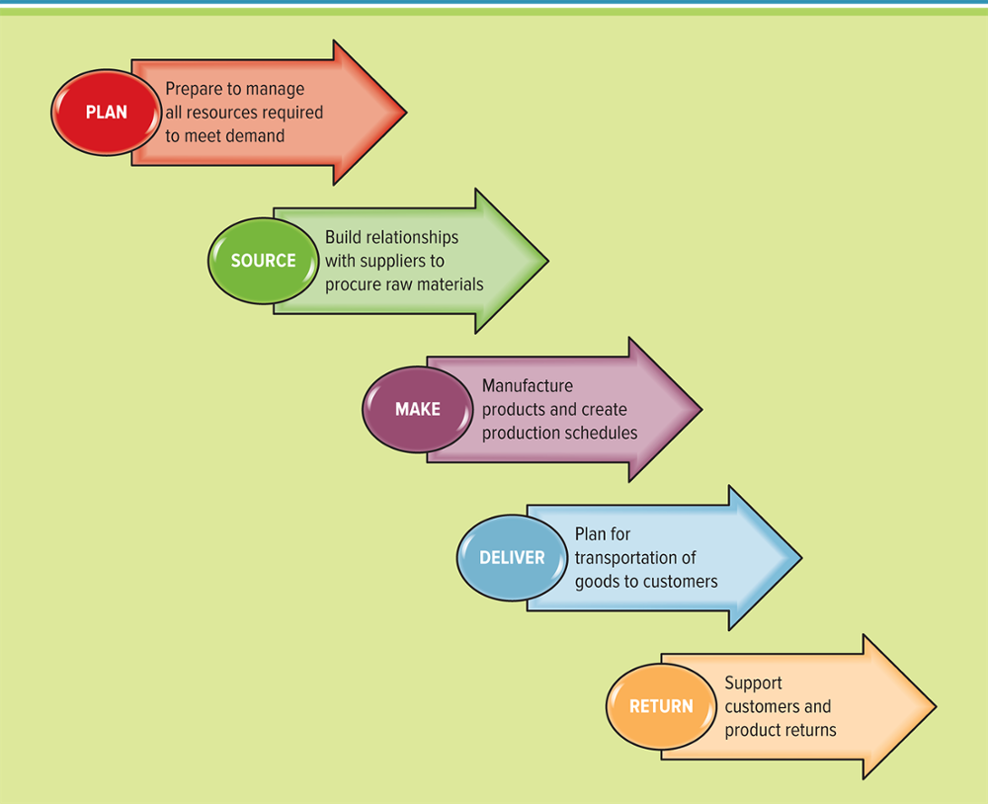
Figure 8.5 The Five Basic Supply Chain Activities
Best buy通過其SCM系統每隔半小時檢查一次北美750家商店的庫存水平,從庫存補貨中得到大量預測
供應鏈管理改善了公司尋找製造產品或服務所需的原始組件，製造產品或服務並將其交付給客戶的方法
Jump to long image description
Notes:
Best Buy checks inventory levels at each of its 750 stores in North America as often as every half-hour with its SCM system, taking much of the guesswork out of inventory replenishment
Supply chain management improves ways for companies to find the raw components they need to make a product or service, manufacture that product or service, and deliver it to customers
Plan: This is the strategic portion of supply chain management. A company must have a plan for managing all the resources that go toward meeting customer demand for products or services. A big piece of planning is developing a set of metrics to monitor the supply chain so that it is efficient, costs less, and delivers high quality and value to customers.
Source: Companies must carefully choose reliable suppliers that will deliver goods and services required for making products. Companies must also develop a set of pricing, delivery, and payment processes with suppliers and create metrics for monitoring and improving the relationships.
Make: This is the step where companies manufacture their products or services. This can include scheduling the activities necessary for production, testing, packaging, and preparing for delivery. This is by far the most metric-intensive portion of the supply chain, measuring quality levels, production output, and worker productivity.
Deliver: This step is commonly referred to as logistics. Logistics is the set of processes that plans for and controls the efficient and effective transportation and storage of supplies from suppliers to customers. During this step, companies must be able to receive orders from customers, fulfill the orders via a network of warehouses, pick transportation companies to deliver the products, and implement a billing and invoicing system to facilitate payments.
Return: This is typically the most problematic step in the supply chain. Companies must create a network for receiving defective and excess products and support customers who have problems with delivered products.

Slide 12
計劃：這是供應鏈管理的築策略部分。公司必須制定計劃來管理滿足客戶對產品或服務需求的所有資源。一項重要的計劃是製定一套指標來監控供應鏈，以便提高效率，降低成本，並為客戶提供高質量和高價值。
資料來源：公司必須謹慎選擇能夠提供製造產品所需的產品和服務的可靠供應商。公司還必須與供應商一起制定一套定價，交付和支付流程，並創建監控和改善關係的指標。
製造：這是公司製造產品或服務的步驟。這可以包括安排生產，測試，包裝和準備交付所需的活動。這是迄今為止供應鏈中度量最密集的部分，用於衡量質量水平，產量和工人生產率。
交付：此步驟通常稱為後勤。物流是一系列流程，用於計劃和控制從供應商到客戶的供應的高效和有效運輸和存儲。在此步驟中，公司必須能夠接收客戶的訂單，通過倉庫網絡履行訂單，選擇運輸公司來交付產品，並實施計費和發票系統以方便付款。
退回：這通常是供應鏈中最有問題的。公司必須建立一個網絡，用於接收有缺陷和過剩的產品，並為有交付產品問題的客戶提供支持。

Slide 13
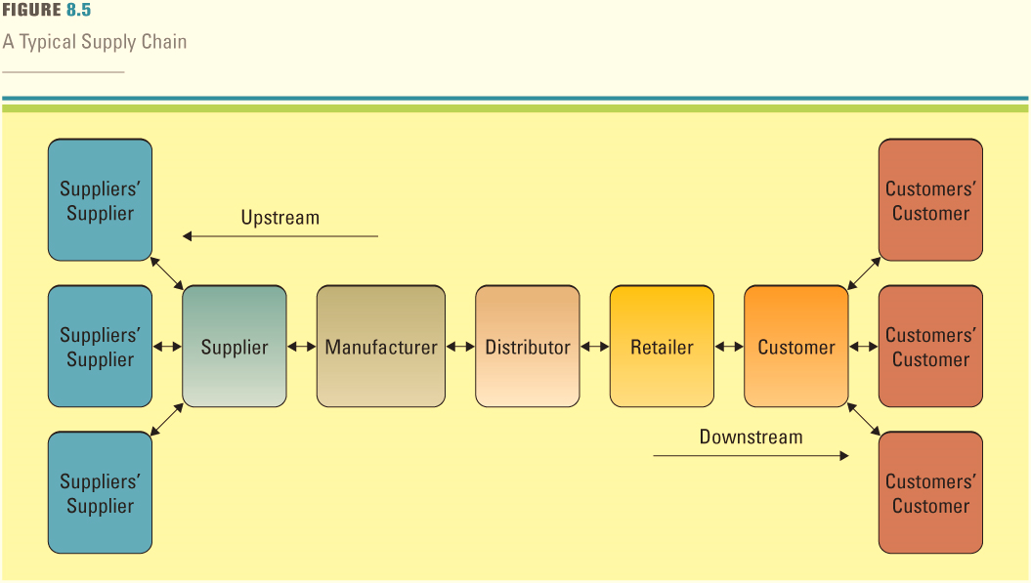
Figure 8.6 A Typical Supply Chain
Supply Chain Management (SCM) – The management of information flows between and among activities in a supply chain to maximize total supply chain effectiveness and profitability
Jump to long image description
Notes:
To help your students understand a supply chain, ask them to discuss and determine the steps typically taken when a customer buys a bike from Trek
Customer places an order for a Trek bike with a store
Store (such as Gart Sports, local bike shop, or local sporting goods store) receives the order
Store receives the payment from the customer
Store orders the bike from Trek
Store sends payment to Trek
Trek orders materials from its suppliers, such as packaging material, metal, and accessories
Trek sends payments to suppliers
Trek receives materials from suppliers
Trek assembles the bike
Trek ships the bike to the store
Customer picks up the Trek bike from the store

Slide 14
Supply Chain Management 1 of 2
The supply chain has three main links:
Materials flow from suppliers and their “upstream” suppliers at all levels
Transformation of materials into semifinished and finished products through the organization’s own production process
Distribution of products to customers and their “downstream” customers at all levels
SCM收集，分析和分發交易信息給所有相關方，幫助供應鏈中的所有不同實體更有效地協同工作
SCM在過去幾年中顯著提高了公司的預測能力, 今天的企業可以利用建模和模擬工具，算法和app，這些工具可以結合來自多個來源的信息，提前幾天，幾周和幾個月構建預測
Notes:
Collecting, analyzing, and distributing transactional information to all relevant parties, SCM systems help all the different entities in the supply chain work together more effectively
SCM has significantly improved companies’ forecasting abilities over the last few years
Businesses today have access to modeling and simulation tools, algorithms, and applications that can combine information from multiple sources to build forecasts for days, weeks, and months in advance
CLASSROOM EXERCISE
Supply Chaining
Break your students into groups and ask them to design a supply chain for an organization of their choice
Ask your students to try to choose an organization that is currently experiencing supply chain issues, perhaps an organization where the student has had recent issues, such as not receiving an order, receiving an incorrect order, or receiving someone else's order
Be sure to have them list the names of the suppliers, manufacturers, distributors, retailers, and customers
Ask the students to identify one or two areas where the organization can improve its supply chain
Have each group present their supply chains to the class along with their recommendations for improvement

Slide 15
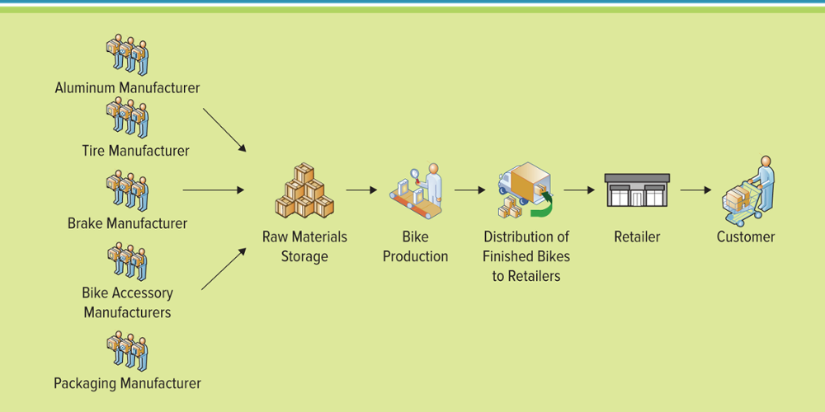
Figure 8.7 Supply Chain for a Bike Manufacturer
Jump to long image description
Notes:
Dozens of steps are required to achieve and carry out each of the supply chain components
The above figure diagrams the typical manufacturing supply chain
SCM software can enable an organization to generate efficiencies within these steps by automating and improving the information flows throughout and among the different supply chain components.

Slide 16
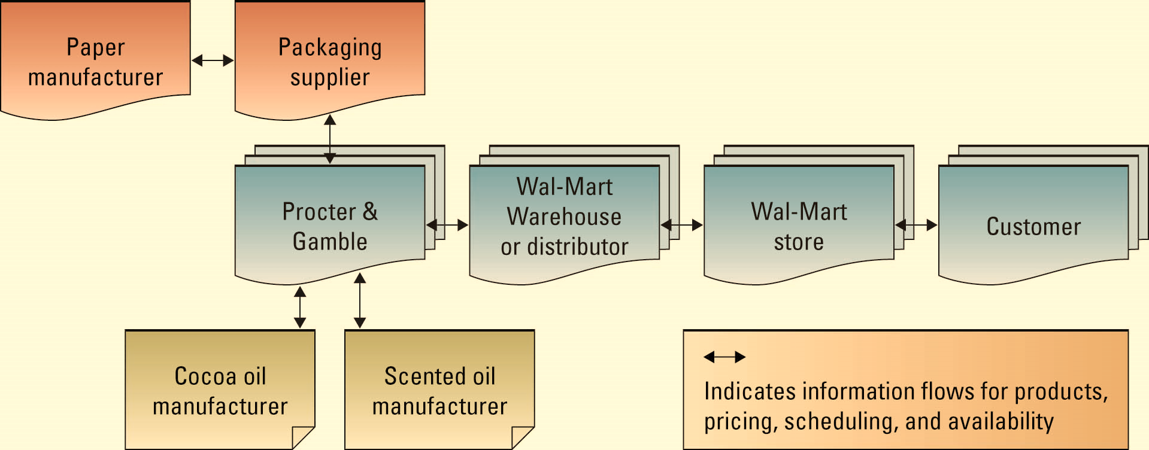
Figure 8.8 Supply Chain for a Product Purchased from Walmart
Each time a Wal-Mart customers purchases a P&G product, the system sends a message directly to P&G’s factory for a reorder
Explain how Wal-Mart’s and P&G’s relationship would be affected if a catastrophic incident destroyed the SCM system?
scented有香味的
Notes:
Wal-Mart and P&G implemented a tremendously successful SCM
System links Wal-Mart’s distribution centers directly to P&G’s manufacturing centers
Each time a Wal-Mart customers purchases a P&G product, the system sends a message directly to P&G’s factory for a reorder
Explain how Wal-Mart’s and P&G’s relationship would be affected if a catastrophic incident destroyed the SCM system?
How would Wal-Mart reorder products?
How would Wal-Mart send payments?
How would P&G know which products to send to Wal-Mart?

Slide 17
Supply Chain Management 2 of 2
Effective and efficient SCM systems can enable an organization to:
Decrease the power of its buyers
Increase its own supplier power
Increase switching costs to reduce the threat of substitute products or services
Create entry barriers thereby reducing the threat of new entrants
Increase efficiencies while seeking a competitive advantage through cost leadership
Notes:
This is a good time to readdress Porter’s Five Forces Model
Ask your students to diagram Porter’s Five Forces and then walk-thru each of the above bullets and explain how SCM is causing this effect
Considerable evidence shows that this type of supply chain integration results in superior supply chain capabilities and profits.
CLASSROOM EXERCISE
Near Beer Supply Chain Game
This is an excellent exercise for students who are just learning about the supply chain.
https://forio.com/simulate/mbean/near-beer-game/overview/

Slide 18
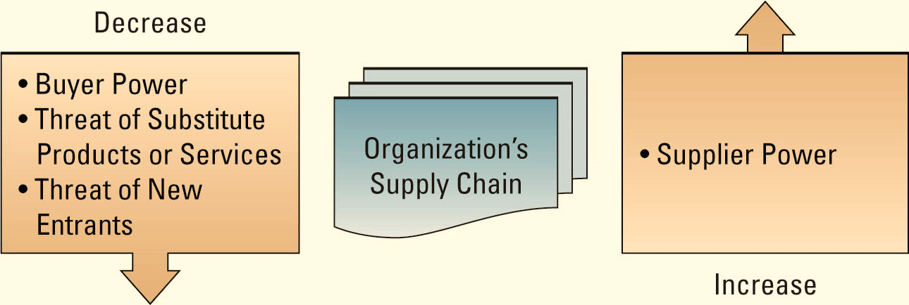
Figure 8.9 Effective and Efficient Supply Chain Management’s Effect on Porter’s Five Forces
為什麼公司希望降低購買力並增加供應能力？
降低購買力使公司具有競爭優勢，正如蘋果公司在推出iPod時所發現的那樣。 作為第一個進入市場並且是產品的唯一供應商，公司處於令人垂涎的位置，能夠設定價格並控制市場
Jump to long image description
Notes:
Is it a good idea to try to influence buyer power and supplier power?
Why would a company wants to decrease its buyer power and increase its supply power?
Decreasing buyer power gives a company a competitive advantage as Apple discovered with the introduction of its iPod. Being the first to market and the only supplier of a product puts the company in the coveted position of being able to set prices and control the market.
Discuss how SCM systems can drive buyer power and supplier power

Slide 19
Visibility Into the Supply Chain
Supply chain visibility – The ability to view all areas up and down the supply chain in real time
Supply chain planning system
Supply chain execution system
Bullwhip effect
Supply chain planning system: Uses advanced mathematical algorithms to improve the flow and efficiency of the supply chain while reducing inventory
Supply chain execution system: Automates the different activities of the supply chain
Bullwhip effect: Occurs when distorted product demand information ripples from one partner to the next throughout the supply chain
Supply chain visibility allows organizations to eliminate the bullwhip effect
Notes:
Visibility: more visible models of different ways to do things in the supply chain have emerged. High visibility in the supply chain is changing industries, as Walmart demonstrated
Supply chain planning system: Uses advanced mathematical algorithms to improve the flow and efficiency of the supply chain while reducing inventory
Supply chain execution system: Automates the different activities of the supply chain
Bullwhip effect: Occurs when distorted product demand information ripples from one partner to the next throughout the supply chain
Supply chain visibility allows organizations to eliminate the bullwhip effect
To explain the bullwhip effect to your students discuss a product that demand does not change, such as diapers. The need for diapers is constant, it does not increase at Christmas or in the summer, diapers are in demand all year long. The number of newborn babies determines diaper demand, and that number is constant.
Retailers order diapers from distributors when their inventory level falls below a certain level, they might order a few extra just to be safe
Distributors order diapers from manufacturers when their inventory level falls below a certain level, they might order a few extra just to be safe
Manufacturers order diapers from suppliers when their inventory level falls below a certain level, they might order a few extra just to be safe
Eventually the one or two extra boxes ordered from a few retailers becomes several thousand boxes for the manufacturer. This is the bullwhip effect, a small ripple at one end makes a large wave at the other end of the whip.

Slide 20
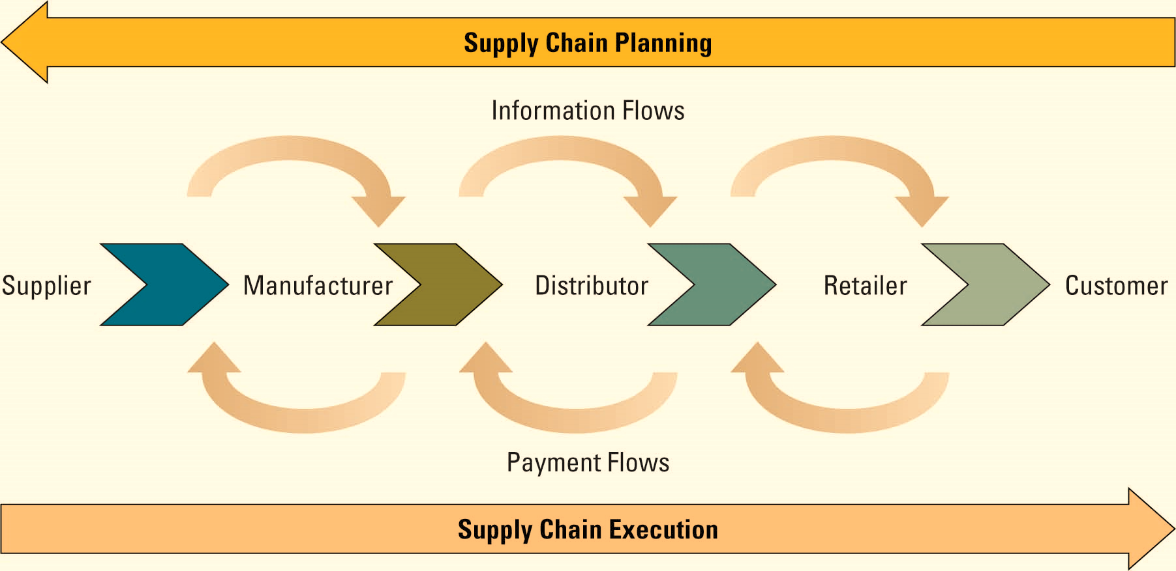
Figure 8.10 Supply Chain Planning’s and Supply Chain Execution’s Roles in the Supply Chain
對尿布的需求是不變的，在聖誕節或夏天不會增加尿布全年需求。 新生嬰兒的數量決定了尿布需求，而且這個數字是不變的。
零售商在庫存水平低於一定水平時從經銷商處訂購紙尿褲，為了安全起見，他們可能會訂購一些額外的紙尿褲
當庫存水平低於某個水平時，經銷商會向製造商訂購紙尿褲，為了安全起見，他們可能會訂購一些額外的紙尿褲
製造商在庫存水平低於某個水平時從供應商處訂購尿布，為了安全起見，他們可能會訂購一些額外的尿布
最終，從一些零售商訂購的一個或兩個額外的盒子變成了幾千個製造商的盒子。 這是牛鞭效應，一端的小波紋在鞭子的另一端產生一個大波浪。
Jump to long image description
Notes:
Ask your students to determine the different types of information flows that would be represented in an SCP system
Ask your students to determine the different types of payment flows that would be represented in an SCE system

Slide 21
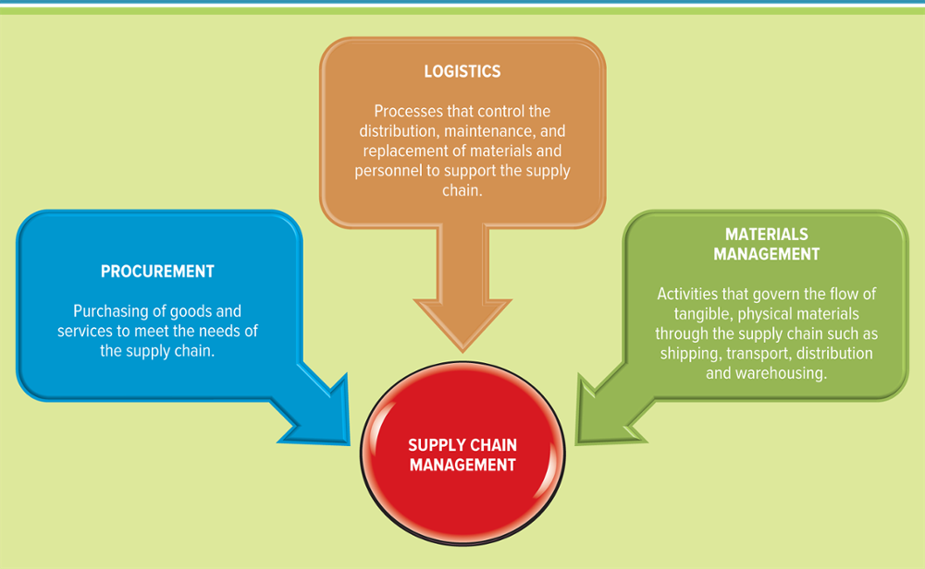
Figure 8.11 The Three Business Areas of Supply Chain Management
Jump to long image description
Notes:
Ask your students to define each component along with what types of questions can be answered by each
Procurement is the purchasing of goods and services to meet the needs of the supply chain.
Procurement can help a company answer the following questions:
What quantity of raw materials should we purchase to minimize spoilage?
How can we guarantee that our raw materials meet production needs?
At what price can we purchase materials to guarantee profitability?
Can purchasing all products from a single vendor provide additional discounts
Logistics includes the processes that control the distribution, maintenance, and replacement of materials and personnel to support the supply chain
Inbound logistics acquires raw materials and resources and distributes them to manufacturing as required.
Outbound logistics distributes goods and services to customers
Logistics can help a company answer the following questions:
What is the quickest way to deliver products to our customers?
What is the optimal way to place items in the warehouse for picking and packing?
What is the optimal path to an item in the warehouse?
What path should the vehicles follow when delivering the goods?
What areas or regions are the trucks covering?
Materials management includes activities that govern the flow of tangible, physical materials through the supply chain such as shipping, transport, distribution, and warehousing.
Materials management can help a company answer the following concerns:
What are our current inventory levels?
What items are running low in the warehouse?
What items are at risk of spoiling in the warehouse?
How do we dispose of spoiled items?
What laws need to be followed for storing hazardous materials?
Which items must be refrigerated when being stored and transported?
What are the requirements to store or transport fragile items?

Slide 22
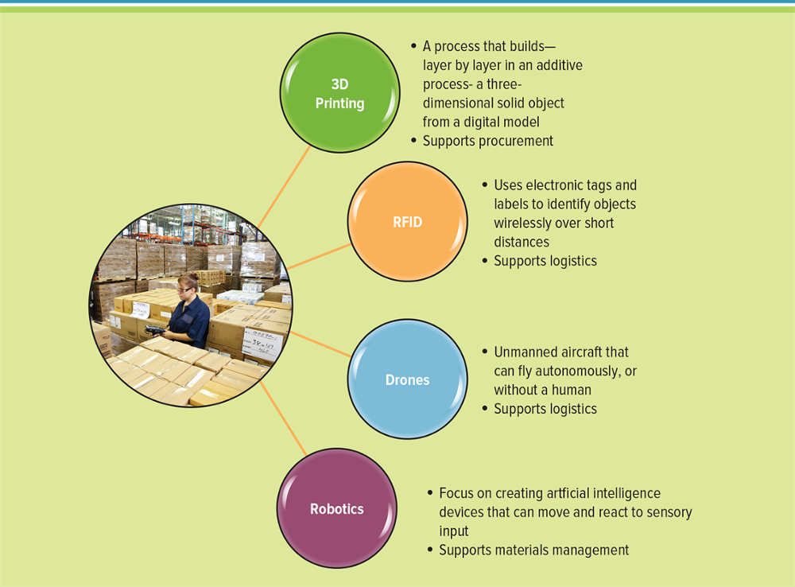
Figure 8.12 Disruptive Business Technologies
Jump to long image description
Notes:
Ask your students to research the Internet and find examples of each type on the Web. There are so many amazing 3D printing examples from college students.
The process of 3D printing (additive manufacturing) builds—layer by layer in an additive process—a three-dimensional solid object from a digital model
The maker movement is a cultural trend that places value on an individual’s ability to be a creator of things as well as a consumer of things.
Makerspaces, a community center that provides technology, manufacturing equipment, and educational opportunities to the public that would otherwise be inaccessible or unaffordable.
Radio-frequency identification (RFID) uses electronic tags and labels to identify objects wirelessly over short distances.
A drone is an unmanned aircraft that can fly autonomously, or without a human. Amazon.com is piloting drone aircraft for package deliveries
Robotics focuses on creating artificial intelligence devices that can move and react to sensory input

Slide 23
The Extended Supply Chain
The fastest growing extensions for supply chain management include:
Supply chain event management (SCEM)
enables an organization to react quickly to resolve supply chain issues
Selling chain management
applies technology to the activities in the order life cycle from inquiry to sale
Collaborative engineering
allows an organization to reduce the costs required during the design process of a product
Collaborative demand planning
helps organizations reduce their investment in inventory, while improving customer satisfaction through product availability
Notes:
Supply chain event management (SCEM): enables an organization to react quickly to resolve supply chain issues
Selling chain management : applies technology to the activities in the order life cycle from inquiry to sale
Collaborative engineering : allows an organization to reduce the costs required during the design process of a product
Collaborative demand planning : helps organizations reduce their investment in inventory, while improving customer satisfaction through product availability
The functionality in supply chain management systems is becoming more and more sophisticated as supply chain management matures
The future stages of SCM will incorporate more functions such as marketing, customer service, and product development
It will also use more advanced communication methods, adoption of more user friendly decision support systems, and availability of shared information to all participants in the supply chain

Slide 24
Section 8.2
CUSTOMER RELATIONSHIP MANAGEMENT AND ENTERPRISE RESOURCE PLANNING

Slide 25
Learning Outcomes 2 of 2
8.4 Explain operational and analytical customer relationship management.
8.5 Identify the core and extended areas of enterprise resource planning.
8.6 Discuss the current technologies organizations are integrating in enterprise resource planning systems.

Slide 26
Customer Relationship Management 1 of 3
Customer relationship management (CRM) – Involves managing all aspects of a customer’s relationship with an organization to increase customer loyalty and retention and an organization's profitability
Many organizations, such as Charles Schwab and Kaiser Permanente, have obtained great success through the implementation of CRM systems
Charles Schwab在不到兩年的時間取得價值數百萬美元成本的CRM系統，該系統允許公司對嚴重和非嚴重投資者的客戶進行區隔。經營經紀業務與銀行業務之理財公司
CRM系統尋找自動提領銀行賬戶的客戶，作為重要投資者的信號。
CRM系統尋找收支平衡的客戶，作為一個非重要投資者的信號
然後，公司可以集中力量向重要的投資者出售，並花更少的時間嘗試向非重要的投資者出售
Notes:
CRM systems help organizations understand and manage their customers
Charles Schwab recouped the cost of a multimillion-dollar CRM system in less than two years
The system allowed Schwab to segment its customers in terms of serious and nonserious investors
The CRM system looked for customers that had automatic withdrawal from a bank account as a sign of a serious investor
The CRM system looked for stagnant balances as a sign of a nonserious investor
Charles Schwab could then focus efforts on selling to serious investors, and spend less time attempting to sell to nonserious investors
Kaiser used CRM to enforce more rigorous eye-screening for diabetic patients
Ask your students to list other organizations that use CRM to increase sales and improve operations
Ritz-Carlton Hotels
Harrah’s
Harley-Davidson

Slide 27
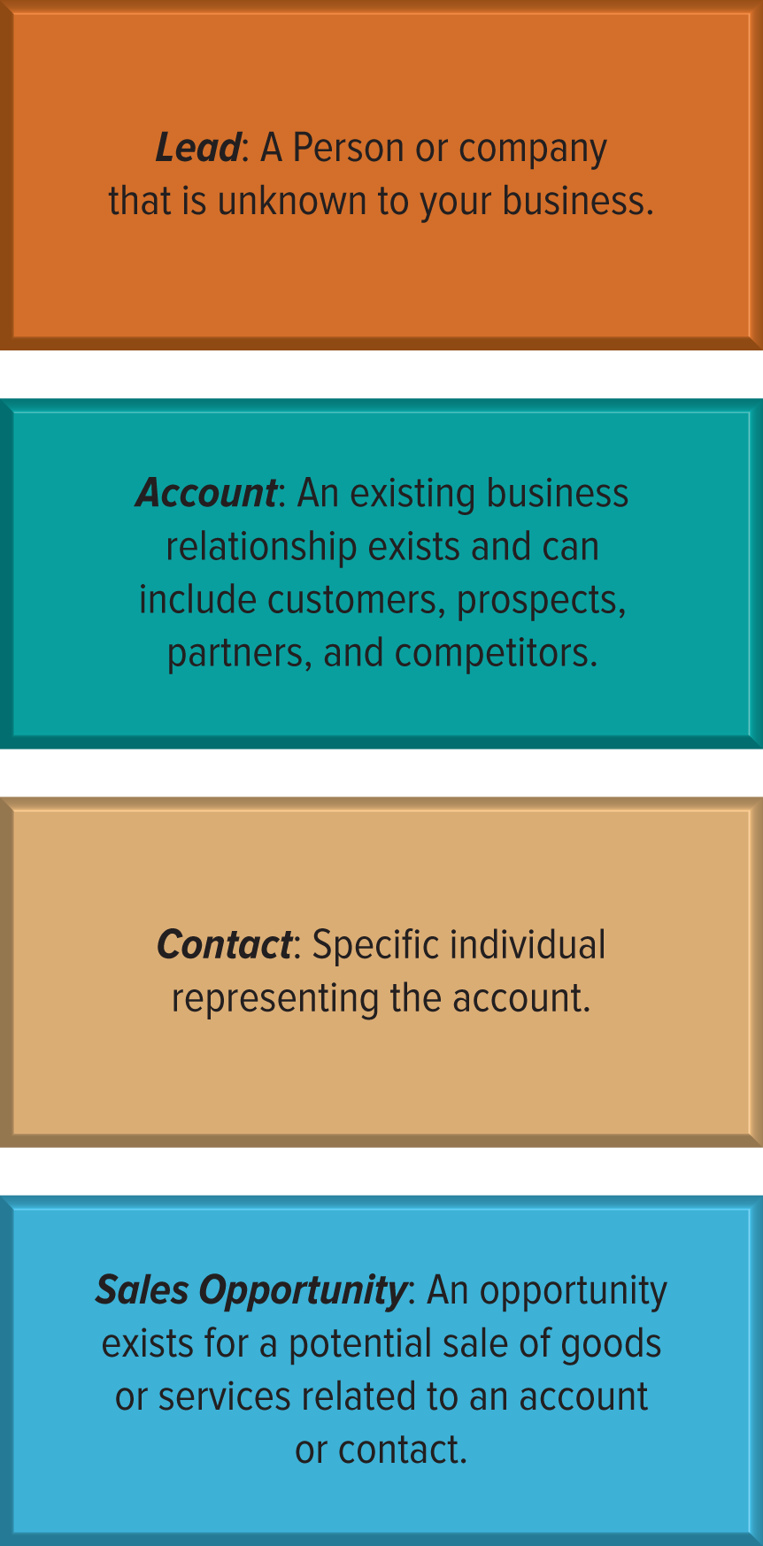
Figure 8.16 Customer Relationship Management Key Players
account老主顾
Notes:
The complicated piece of the CRM puzzle is identifying customers and the many communication channels they use to contact companies, including call centers, web access, email, sales representatives, faxes, and cell phones. A single customer may access an organization multiple times through many different channels

Slide 28
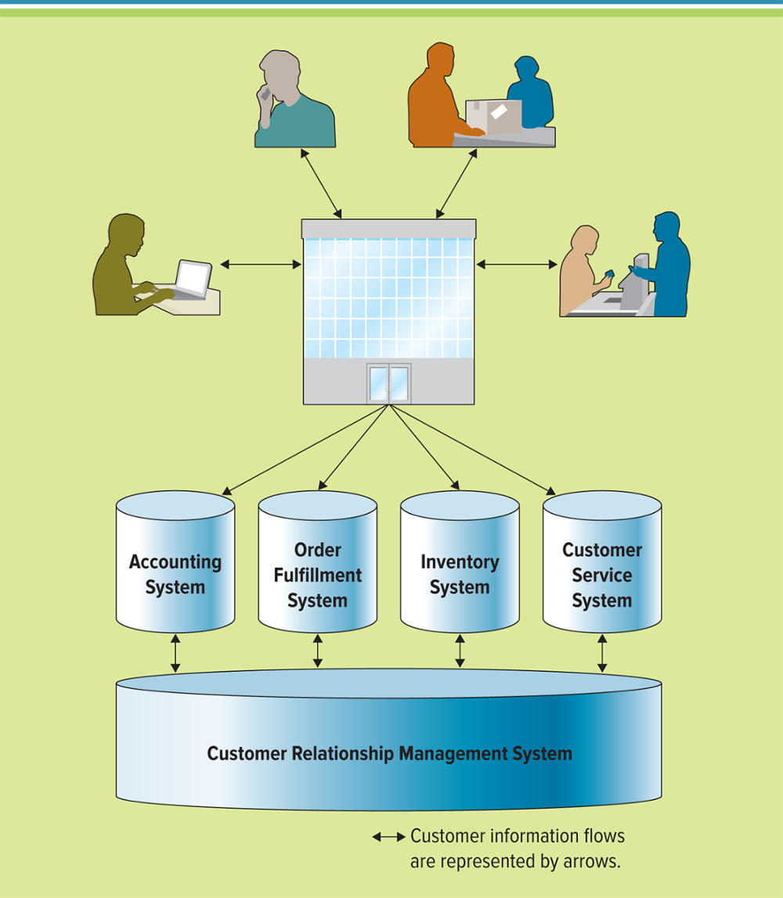
Figure 8.18 Customer Relationship Management Overview
Text message
Instant message
Voice mail
Voice call
Email letter
Web order
Phone order
Meeting
Customer service call
Twitter
Facebook
Jump to long image description
Notes:
Customers contact organizations multiple times through numerous channels
Each contact can be stored in a different system or different database. For example, a sales call and a billing call will be maintained in two different databases
The CRM system tracks all of the different contacts through the various channels and collates the information into a central repository
This gives the organization a complete and total view of its customers, along with their purchases, questions, issues, and concerns, in one single place
Why is it so important for an organization to embrace CRM on an enterprisewide level?
What happens if only one division in an organization embraced CRM? (not enterprisewide)
What happens if the customer service system or order fulfillment system were not part of the CRM system in the above diagram?
How would the company determine orders or provide customer service?

Slide 29
Customer Relationship Management 2 of 3
Organizations can find their most valuable customers through “RFM” – Recency, Frequency, and Monetary value
How recently a customer purchased items
How frequently a customer purchased items
The monetary value of each customer purchase
Notes:
Once a company knows this information, it can begin to strategize marketing campaigns, sales promotions, and other ways to increase business
For example: If Ms. Smith buys only at the height of the season, then the company should send her a special offer during the “off-season”
Ask your students if they have received any personalized promotions lately
How did the company gather information on the student to be able to offer the personalized promotion? CRM is not just a technology, but a strategy that an organization must embrace on an enterprisewide level
Although CRM has many technical components, it is actually a process and business goal simply enhanced by technology
Organizations must first decide that they want to build strong customer relationships and then they determine how IT can support their goals
Provide examples of bad customer experiences you have had in the past
Are you still doing business with that company?
What could the company have done to attempt to keep your business?
Do you see the value in CRM and how beneficial it can be for an organization to develop and maintain strong customer relationships?

Slide 30
Customer Relationship Management 3 of 3
CRM reporting technologies – Help organizations identify their customers across other applications
CRM analysis technologies – Help organizations segment their customers into categories such as best and worst customers
CRM predicting technologies – Help organizations make predictions regarding customer behavior such as which customers are at risk of leaving
Implementing a CRM Strategy
Organizations can find their most valuable customers through “RFM” - Recency, Frequency, and Monetary value
How recently a customer purchased items (Recency)
How frequently a customer purchased items (Frequency)
How much a customer spends on each purchase (Monetary Value)
Notes:
Reporting
Help organizations identify their customers across applications
Analyzing
Help organizations segment their customers into categories such as best and worst customers
Predicting
Help organizations make predictions regarding customer behavior such as which customers are at risk of leaving
Ask your students to define additional examples of reporting, analyzing, and predicting questions
CLASSROOM EXERCISE
Implementing a CRM Strategy
Organizations can find their most valuable customers through “RFM” - Recency, Frequency, and Monetary value
How recently a customer purchased items (Recency)
How frequently a customer purchased items (Frequency)
How much a customer spends on each purchase (Monetary Value)
Break your students into groups and ask them to form a CRM strategy for a new company that sells office supplies. Have your students present their strategy to the class. The strategy should address how to gain new customers and how to keep existing customers. For example,
The company should create personal promotions for its best customers
The company should target new customers in the surrounding area, especially business customers
The company should try to buy a list of business customers in the area from a valid source
The company should advertise in local trade papers, newspapers, radio stations, and restaurants
The company should track the responses it receives from the various advertising sources

Slide 31
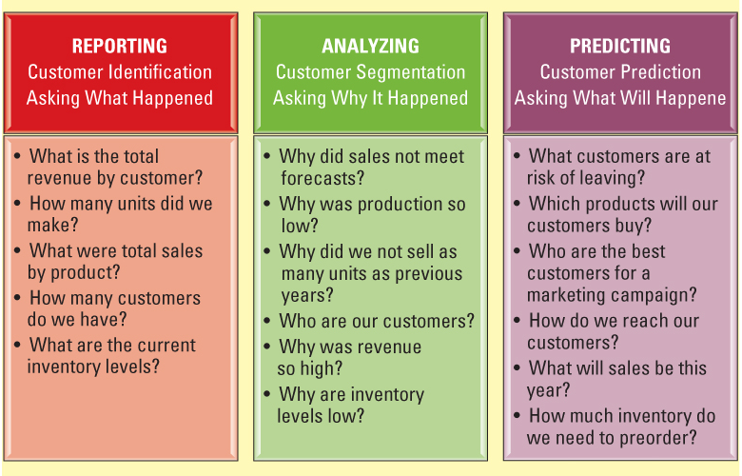
Figure 8.19 Evolution of CRM
Jump to long image description
Notes:
As the business world increasingly shifts from product-focus to customer-focus, most organizations recognize that treating existing customers well is the best source of profitable and sustainable revenue growth
Ask your students why, in the age of e-business, an organization is challenged more than ever before to truly satisfy its customers

Slide 32
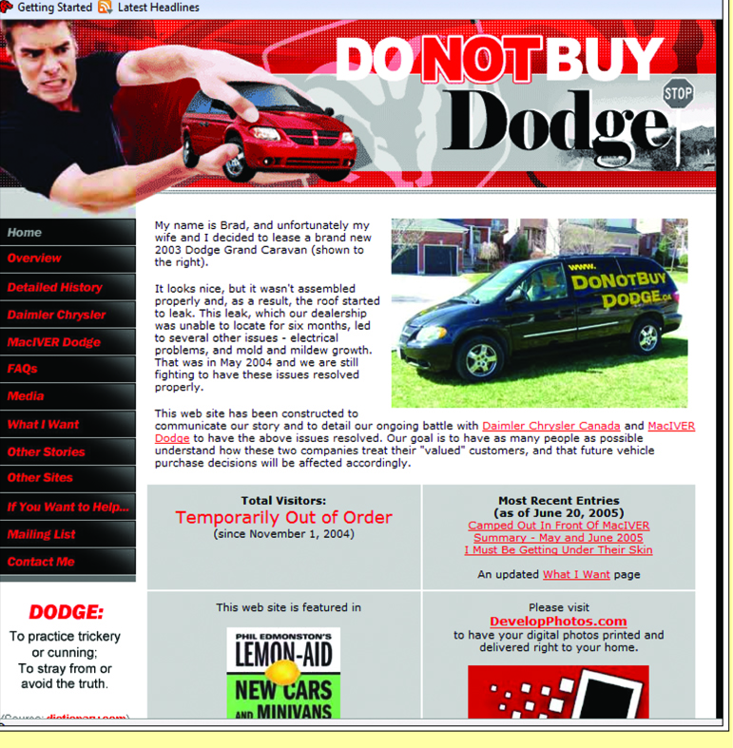
Figure 8.20 The Power of the Customer
The customer is always right and now has more power than ever thanks to the Internet
Notes:
Ask your students how a customer complained prior to the invention of the Internet?
They wrote a letter, made a phone call, visited in person. The bottom line is the impact of one person was minimal
Ask your students how customers complain today?
Blogs, websites, emails, etc.: one person can easily impact millions of people by using the Internet

Slide 33
Figure 8.21 CRM Metrics 1 of 2
Sales Metrics | Customer Service Metrics | Marketing Metrics
Number of prospective customers潛在客戶 | Cases closed same day | Number of marketing campaigns
Number of new customers | Number of cases handled by agent | New customer retention rates
Number of retained customers | Number of service calls | Number of responses by marketing campaign
Number of open leads開放引線客戶 | Average number of service requests by type | Number of purchases by marketing campaign
Number of sales calls | Average time to resolution | Revenue generated by marketing campaign
Notes:
Using CRM metrics to track and monitor performance is a best practice for many companies.
The figure displays a few common CRM metrics a manager can use to track the success of the system.
Just remember that you only want to track between five and seven of the hundreds of CRM metrics available
Ask your students for examples of how they would use a few of the metrics to track the success of a restaurant, hotel, or local business

Slide 34
Figure 8.21 CRM Metrics 2 of 2
Sales Metrics | Customer Service Metrics | Marketing Metrics
Number of sales calls per lead每個潛在客戶的銷售電話數量 | Average number of service calls per day | Cost per interaction by marketing campaign活動
Amount of new revenue | Percentage compliance with service-level agreement | Number of new customers acquired by marketing campaign
Amount of recurring revenue经常性收入 | Percentage of service renewals合续订同的 | Customer retention rate
Number of proposals given | Customer satisfaction level | Number of new leads by product
Using CRM metrics to track and monitor performance is a best practice
a few common CRM metrics a manager can use to track the success of the system.
you only want to track between five and seven of the hundreds of CRM metrics available
Notes:
Using CRM metrics to track and monitor performance is a best practice for many companies.
The figure displays a few common CRM metrics a manager can use to track the success of the system.
Just remember that you only want to track between five and seven of the hundreds of CRM metrics available
Ask your students for examples of how they would use a few of the metrics to track the success of a restaurant, hotel, or local business

Slide 35
Operational and Analytical CRM
Operational CRM – Supports traditional transactional processing for day-to-day front-office前台operations or systems that deal directly with the customers
Analytical CRM – Supports back-office operations and strategic analysis and includes all systems that do not deal directly with the customers
Notes:
Can you list a few examples of front-office systems?
Customer service, sales, billing
Can you list a few examples of back-office systems?
Accounting, finance, human resources, data warehouses
Ask your students which systems are more important to an organization – front-office or back-office
Ans: Both, one cannot function without the other
CLASSROOM EXERCISE
Designing a Digital Dashboard for a CRM System
Digital dashboards offer an effective and efficient way to view enterprisewide information at near real-time. According to Nucleus Research, there is a direct correlation between use of digital dashboards and a company’s return on investment (ROI), hence all executives should be using or pushing the development of digital dashboards to monitor and analyze organizational operations.
Break your students into groups and ask them to develop a digital dashboard for a CRM system. Be sure your students have addressed all of the following in their digital dashboard:
Customers
Sales
Marketing
Customer service
Order entry
Billing
Collections
Credit limits
Shipping
Transportation

Slide 36
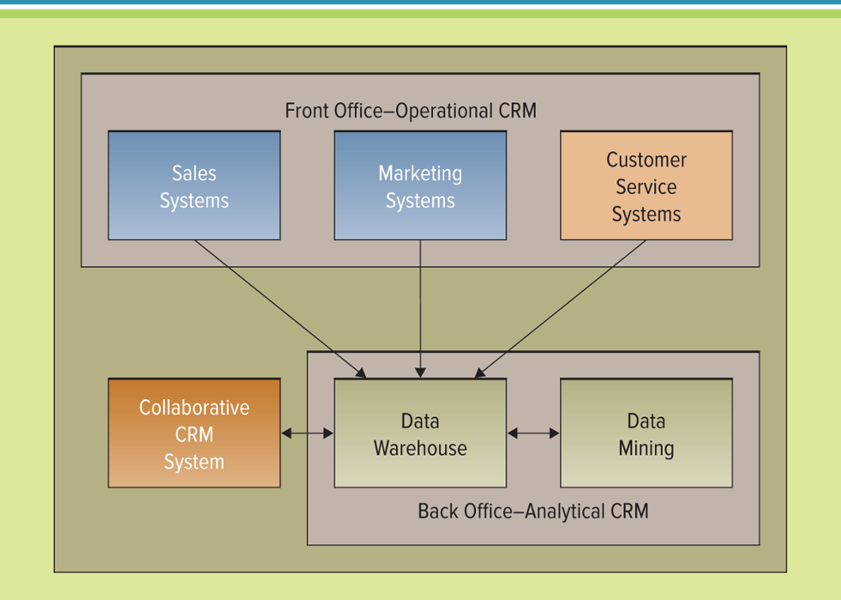
Figure 8.22 Operational CRM and Analytical CRM
Jump to long image description
Notes:
Walk-through the Figure with your students
Why would an organization have a separate system for each front-office system and each back-office system?
Most organizations operate functional “silos”, and each department typically has its own systems
A company might purchase an ERP and then all of the functional silos would be on one system, however, this doesn’t happen very often in the real world. Most organizations require anywhere from 10 to 100 to 1,000 different systems to run their business
Finding one system that could meet all the needs of an entire organization from billing to sales is almost impossible
For this reason, the CRM system is the integrator, gathering all of the customer information from the many different system to obtain a single view of the customer
Personalization is one of the benefits of an analytical CRM system
Personalization occurs when a Web site can know enough about a person’s likes and dislikes that it can fashion offers that are more likely to appeal to that person

Slide 37
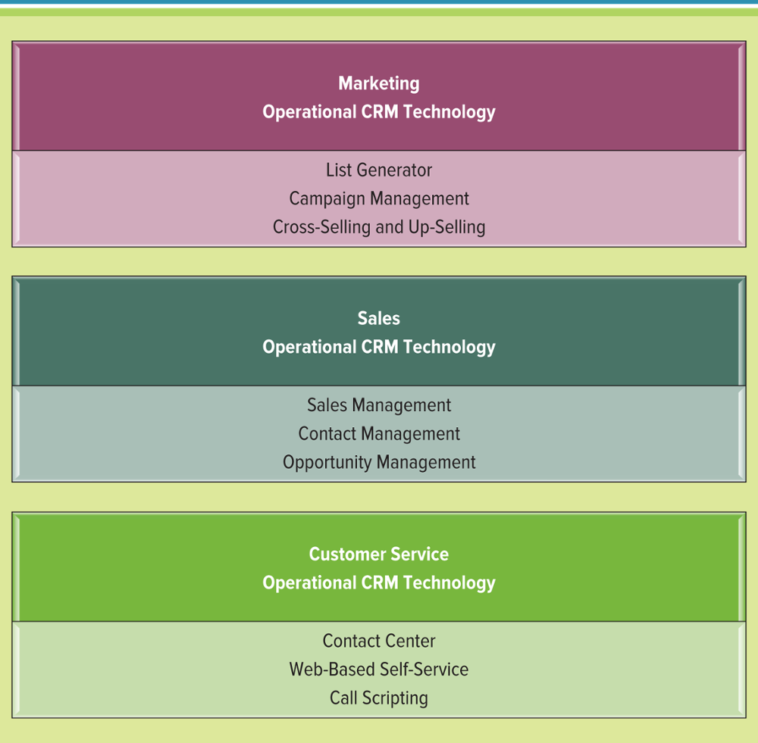
Figure 8.23 Operational CRM Technologies
Call scripting調用對話腳本系統
Notes:
Operational CRM technologies for sales, marketing, and customer service departments
Marketing and operational CRM technology
List generator, campaign management, cross-selling and up-selling
Sales and operational CRM technology
Sales management, contact management, opportunity management
Customer service and operational CRM technology
Contact center, Web-based self-service, call scripting

Slide 38
Marketing and Operational CRM
Three marketing operational CRM technologies
List generator 清單列表產生器
Campaign management system
Cross-selling and up-selling
Notes:
How many of you are marketing majors?
Do you anticipate using these types of technologies in the marketing department?

Slide 39
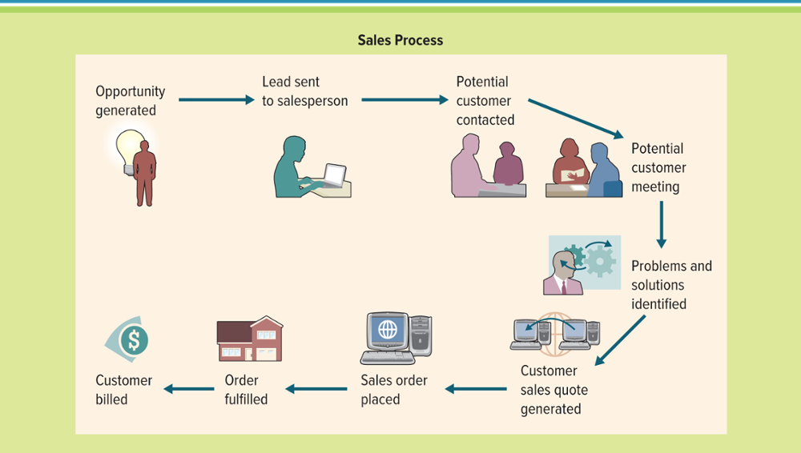
Figure 8.24 A Typical Sales Process
The sales department was the first to begin developing CRM systems with sales force automation – A system that automatically tracks all of the steps in the sales process
Jump to long image description
Notes:
Walk your students through the sales process displayed in the above figure
Ask your students how they could use Microsoft CRM to help a start-up business grow and increase sales

Slide 40
Sales and Operational CRM
Sales and operational CRM technologies
Sales management CRM system
Contact management CRM system
Opportunity management CRM system
Sales management CRM system: Automates each phase of the sales process, helping individual sales representatives coordinate and organize all of their accounts
Contact management CRM system: Maintains customer contact information and identifies prospective customers for future sales
Opportunity management CRM systems: Targets sales opportunities by finding new customers or companies for future sales
Notes:
Sales management CRM system: Automates each phase of the sales process, helping individual sales representatives coordinate and organize all of their accounts
Contact management CRM system: Maintains customer contact information and identifies prospective customers for future sales
Opportunity management CRM systems: Targets sales opportunities by finding new customers or companies for future sales

Slide 41
Customer Service and Operational CRM
Three customer service operational CRM technologies
Contact center (call center)
Web-based self-service system
Call scripting system
Common features included in contact centers:
Automatic call distribution
Interactive voice response
Predictive dialing
Call scripting system: access organizational databases that track similar issues or questions and automatically generate the details to the CSR who can then relay them to the customer. Interactive voice response指導客戶使用按鍵式電話或關鍵字來導航或提供信息
Predictive dialing: Automatically dials outbound calls and when someone answers, the call is forwarded to an available agent.
Notes:
Contact center (call center): where CSRs answer customer inquiries and respond to problems through different touchpoints
Web-based self-service system: allow customers to use the Web to find answers to their questions or solutions to their problems
Click-to-talk: customers click on a button and talk with a CSR via the Internet
Call scripting system: access organizational databases that track similar issues or questions and automatically generate the details to the CSR who can then relay them to the customer
Documedics is a health care consulting company that provides reimbursement information about pharmaceutical products to patients and health care professionals. The company currently supports inquiries for 12 pharmaceutical companies and receives over 30,000 customer calls per month. Originally, the company had a data file for each patient and for each pharmaceutical company. This inefficient process resulted in the potential for a single patient to have up to 12 different information files if the patient was a client of all 12 pharmaceutical companies. To answer customer questions, a CSR had to download each customer file causing tremendous inefficiencies and confusion.
Automatic call distribution: A phone switch routes inbound calls to available agents.
Interactive voice response (IVR): Directs customers to use touch-tone phones or keywords to navigate or provide information.
Predictive dialing: Automatically dials outbound calls and when someone answers, the call is forwarded to an available agent.
A contact center is part of the customer service department and falls into the category of operational CRM
A contact center (call center) is where CSRs answer customer inquiries and respond to problems through different touchpoints
A contact center is one of the best assets a customer-driven organization can have because maintaining a high level of customer support is critical to obtaining and retaining customers
Automatic call distribution, IVR, and predictive dialing are only three of many different systems available to help an organization automate its contact centers

Slide 42
Analytical CRM
Website personalization – Occurs when a website has stored enough data about a person’s likes and dislikes to fashion offers more likely to appeal to that person
Analytical CRM relies heavily on data warehousing technologies and business intelligence to glean收集insights into customer behavior
These systems quickly aggregate, analyze, and disseminate customer information throughout an organization
Notes:
Analytical CRM has the ability to provide an organization with information about their customers that was previously impossible to locate, and the resulting payback can be tremendous.

Slide 43
Extending CRM
Current trends include:
Supplier relationship management (SRM)
Partner relationship management (PRM)
Employee relationship management (ERM)
SRM applications help companies analyze vendors based on a number of key variables including strategy, business goals, prices, and markets. The company can then determine the best supplier to collaborate with and can work on developing strong supplier relationships with that supplier.
PRM’s business strategy is to select and manage partners to optimize their long-term value to an organization. In effect, it means picking the right partners, working with them to help them be successful in dealing with mutual customers, and ensuring that partners and the ultimate end customers are satisfied and successful.
Many ERM applications assist the employee in dealing with customers by providing detailed information on company products, services, and customer orders. ERM applications typically offer expense tracking, project management tracking, performance appraisals, training, benefits, and company news
Notes:
Supplier relationship management (SRM): focuses on keeping suppliers satisfied by evaluating and categorizing suppliers for different projects, which optimizes supplier selection
Partner relationship management (PRM): focuses on keeping vendors satisfied by managing alliance partner and reseller relationship that provide customers with the optimal sales channel
Employee relationship management (ERM): provides employees with a subset of CRM applications available through a Web browser
Supplier relationship management (SRM) focuses on keeping suppliers satisfied by evaluating and categorizing suppliers for different projects, which optimizes supplier selection. SRM applications help companies analyze vendors based on a number of key variables including strategy, business goals, prices, and markets. The company can then determine the best supplier to collaborate with and can work on developing strong supplier relationships with that supplier. The partners can then work together to streamline processes, outsource services, and provide products that they could not provide individually.
Partner relationship management (PRM) focuses on keeping vendors satisfied by managing alliance partner and reseller relationships that provide customers with the optimal sales channel. PRM’s business strategy is to select and manage partners to optimize their long-term value to an organization. In effect, it means picking the right partners, working with them to help them be successful in dealing with mutual customers, and ensuring that partners and the ultimate end customers are satisfied and successful.
Employee relationship management (ERM) provides employees with a subset of CRM applications available through a Web browser. Many ERM applications assist the employee in dealing with customers by providing detailed information on company products, services, and customer orders. ERM applications typically offer expense tracking, project management tracking, performance appraisals, training, benefits, and company news.

Slide 44
Enterprise Resource Planning 1 of 2
Enterprise resource planning – Integrates all departments and functions throughout an organization into a single IT system (or integrated set of IT systems) so that employees can make enterprisewide decisions by viewing enterprisewide information on all business operations
Notes:
This section covers:
Core ERP components
Extended ERP components
ERP benefits
ERP risks
Future of ERP

Slide 45
Enterprise Resource Planning 2 of 2
Reasons ERP systems are powerful tools
ERP is a logical solution to incompatible applications
ERP addresses global information sharing and reporting
ERP avoids the pain and expense of fixing legacy systems
The true benefit of an ERP system is its ability take the many different forms of data from across the different organizational systems and correlate, aggregate, and provide an enterprisewide view of organizational information
Most organizations operate functional “silos”, and each department typically has its own systems. A company might purchase an ERP and then all of the functional silos would be on one system, however, this doesn’t happen very often in the real world
An organization can purchase an ERP and still have other applications running parts of its business (for example, taxation packages) that are not supported, or not supported well, by the ERP system
Notes:
The world's ten largest ERP implementation successful cases
The aluminum company (Alcoa)
Germany BASF company (BASF Aktiengesellschaft)
the first Capital Financial company (Capital One Financial Corp.)
Colgate-palm company (Colgate-Palmolive)
DaimlerChrysler (DaimlerChrysler)
Del have food company, Del Monte Foods)
the Dow Corning company (Dow Corning)
FedEx air company (FedEx)
the Home Depot corporation (Home Depot)
Whirlpool company (Whirlpool)

Slide 46
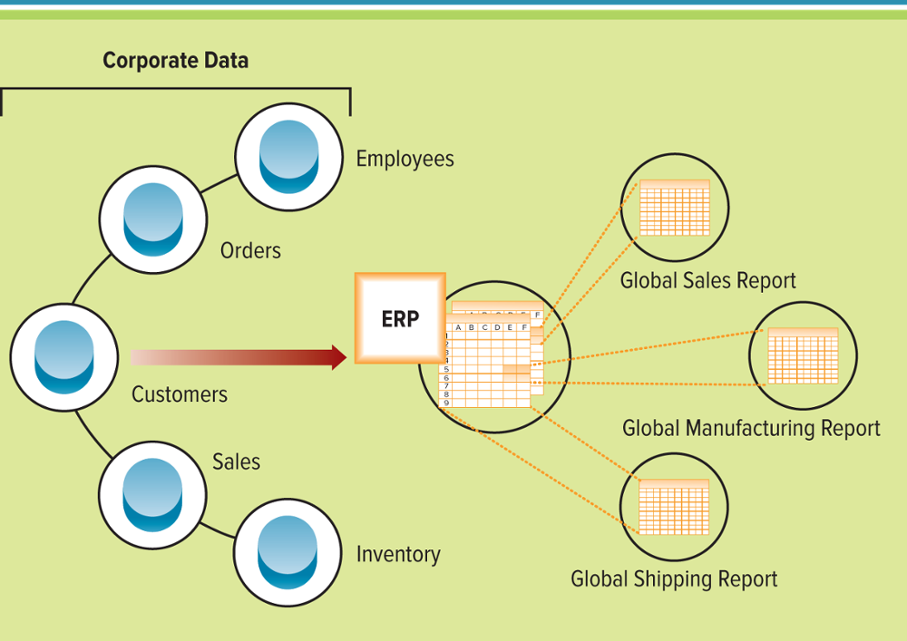
Figure 8.29 Enterprise Resource Planning System Overview
ERP systems collect data from across an organization and correlate the data generating an enterprise-wide view
Jump to long image description
Notes:
The true benefit of an ERP system is its ability take the many different forms of data from across the different organizational systems and correlate, aggregate, and provide an enterprisewide view of organizational information
The two previous spreadsheets display examples of differences in data that can be fixed by using an ERP system
Ask your students why it is important to have an enterprisewide view of data?
Without understanding how all of the different divisions, products, departments, etc. are operating you cannot run the business
Why do organizations need integrations, if an ERP system contains one database that connects all applications together?
Most organizations operate functional “silos”, and each department typically has its own systems
A company might purchase an ERP and then all of the functional silos would be on one system, however, this doesn’t happen very often in the real world
Most organizations require anywhere from 10 to 100 to 1,000 different systems to run their business
Finding one system that could meet all the needs of an entire organization from billing to sales is almost impossible, “sort of a utopia”
An organization can purchase an ERP and still have other applications running parts of its business (for example, taxation packages) that are not supported, or not supported well, by the ERP system

Slide 47
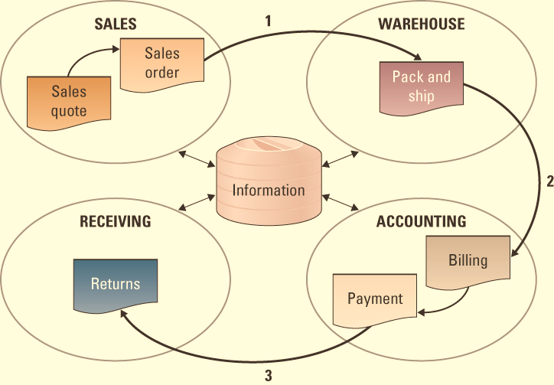
Figure 8.31 ERP Process Flow
ERP Systems Automate Business Processes
Jump to long image description
Notes:
ERP systems automate business processes, for example, order fulfillment
When a CSR takes an order from a customer, he or she has all the information necessary to complete the order (the customer’s credit rating and order history, the company’s inventory levels, and the delivery schedule)
Since the company is using an ERP, everyone else in the company will automatically see the information that the CSR types into the ERP system
When one department finishes with the order, it is automatically routed via the ERP system to the next department
To determine where an order is at any point in time, a user only needs to login to the ERP system and track it down

Slide 48
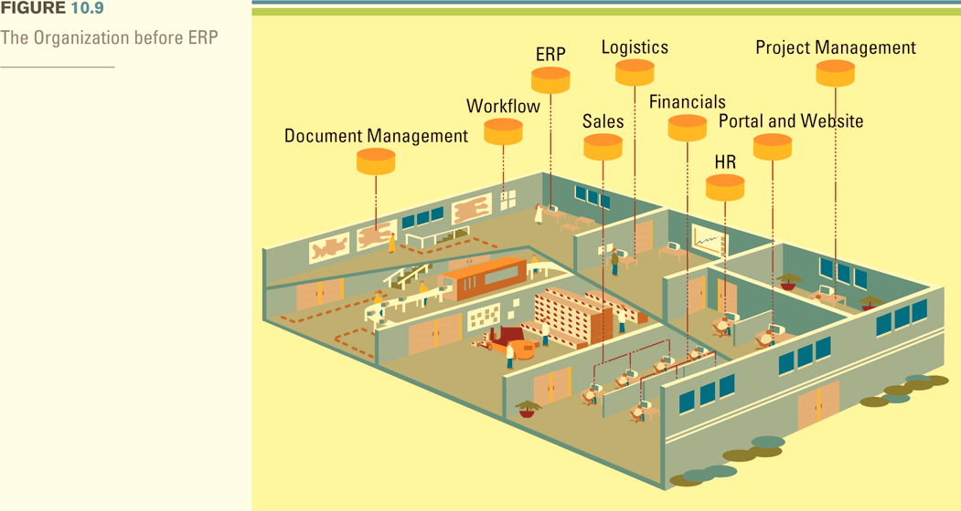
Figure 8.32 The Organization before and after ERP 1 of 2
The Organization Before ERP
Jump to long image description
Notes:
In most organizations, information has traditionally been isolated within specific departments, whether on an individual database, in a file cabinet, or on an employee’s PC. ERP enables employees across the organization to share information across a single, centralized database. With extended portal capabilities, an organization can also involve its suppliers and customers to participate in the workflow process, allowing ERP to penetrate the entire value chain, and help the organization achieve greater operational efficiency
When reviewing this diagram demonstrate to the students how each department has its own database separate from all other organizational departments
Ask your student what types of problems could occur if all departments maintain their own database and systems?
Update issues
Redundancy
Inaccurate information across databases
Different formats of information in the different databases
Inability to access other department information and not being provided with a 360 degree view of the organization
Different customer information in different databases
Customer contact from multiple departments with different messages

Slide 49
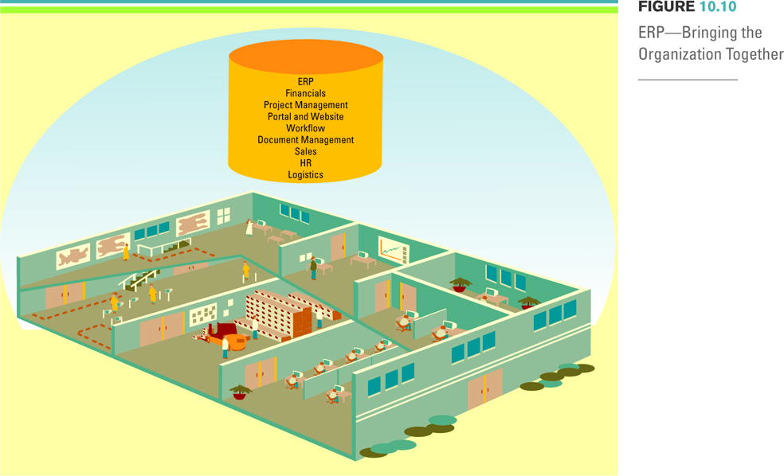
Figure 8.32 The Organization before and after ERP 2 of 2
ERP Bringing The Organization Together
Jump to long image description
Notes:
In most organizations, information has traditionally been isolated within specific departments, whether on an individual database, in a file cabinet, or on an employee’s PC. ERP enables employees across the organization to share information across a single, centralized database. With extended portal capabilities, an organization can also involve its suppliers and customers to participate in the workflow process, allowing ERP to penetrate the entire value chain, and help the organization achieve greater operational efficiency
When discussing this slide be sure to explain to your students how one database that supports the entire organization could eliminate many of the issues discussed on the previous slide
Ask your students what issues could be caused by having one database that supports the entire organization?
Not as flexible and far more difficult to change
Might not meet all department needs as well as an individual specific system
Multiple access levels increases security issues
Ethical dilemmas from accessing different department information – such as payroll

Slide 50
The Benefits of ERP
Core ERP component – Traditional components included in most ERP systems that primarily focus on internal operations
Extended ERP component – Extra components that meet the organizational needs not covered by the core components that primarily focus on external operations
Turner Industries由於實施了ERP系統， Turner Industries在不到10年的時間裡從銷售額的3億美元增長到8億美元。 Turner Industries在Forbes 500企業名單中排名第369位，是一家領先的工業服務公司。 Turner Industries開發和部署先進的軟體應用程序，目的在最大的提高其25,000名員工生產率和超過1億美元的建築設備的價值。
Notes:
Turner Industries grew from $300 million in sales to $800 million in sales in less than 10 years thanks to the implementation of an ERP system. Ranked number 369 on the Forbes 500 list of privately held companies, Turner Industries is a leading industrial services firm. Turner Industries develops and deploys advanced software applications designed to maximize the productivity of its 25,000 employees and construction equipment valued at more than $100 million.

Slide 51
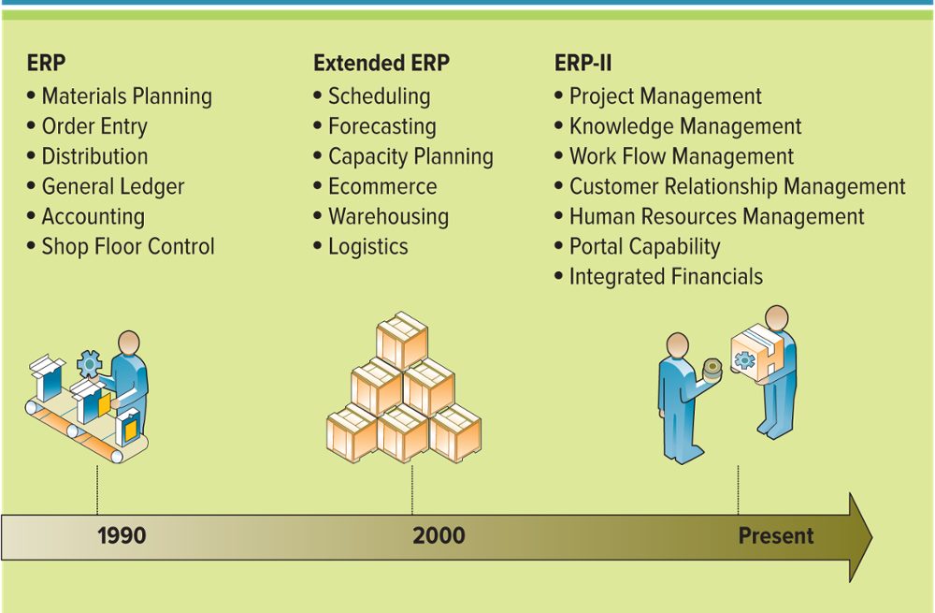
Figure 8.33 The Evolution of ERP (add ?)
製造現場控制
Shop floor control製造現場控制
Notes:
This is an excellent diagram that displays where ERP started and where it is headed
Ask your students what components might be included in an ERP system in the future
Second Life component
Wiki component
Collaboration
CLASSROOM EXERCISE
Designing a Digital Dashboard for an ERP System
Digital dashboards offer an effective and efficient way to view enterprisewide information at near real-time. According to Nucleus Research, there is a direct correlation between use of digital dashboards and a company’s’ return on investment (ROI), hence all executives should be using or pushing the development of digital dashboards to monitor and analyze organizational operations.
Break your students into groups and ask them to develop a digital dashboard for an ERP system. Review the digital dashboards on page 98. Be sure your students have addressed all of the following in their digital dashboard:
Accounting
Finance
Logistics
Production
Distribution
Manufacturing
Human resources
SCM
CRM
n component (IM)

Slide 52
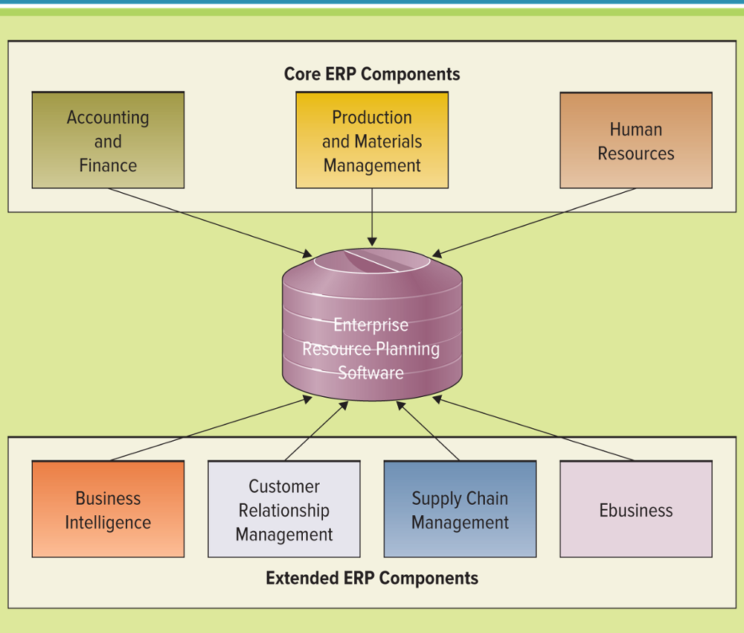
Figure 8.35 Core ERP Components and Extended ERP Components
Jump to long image description
Notes:
Core ERP components: traditional components included in most ERP systems and they primarily focus on internal operations
Extended ERP components: extra components that meet the organizational needs not covered by the core components and primarily focus on external operations

Slide 53
Core ERP Components
Three most common core ERP components
Accounting and finance
Production and materials management
Human resource
Notes:
Accounting and finance components: manage accounting data and financial processes within the enterprise with functions such as general ledger, accounts payable, accounts receivable, budgeting, and asset management
Production and materials management components: handle the various aspects of production planning and execution such as demand forecasting, production scheduling, job cost accounting, and quality control
Human resource components: track employee information including payroll, benefits, compensation, performance assessment, and assumes compliance with the legal requirements of multiple jurisdictions and tax authorities

Slide 54
Accounting and Finance ERP Components
Accounting and finance ERP component – Manages accounting data and financial processes within the enterprise with functions such as general ledger, accounts payable, accounts receivable, budgeting, and asset management
Notes:
Discuss the Harley-Davidson example
Deeley Harley-Davidson Canada (DHDC), the exclusive Canadian distributor of Harley-Davidson motorcycles, has improved inventory, turnaround time, margins, and customer satisfaction; all with the implementation of a financial ERP system. The system has opened up the power of information to the company and is helping it make strategic decisions when it still has the time to change things. The ERP system provides the company with ways to manage inventory, turnaround time, and utilize warehouse space more effectively.
Credit-management feature set limits on how much a customer can owe at any time
Product profitability analysis feature allows companies to perform all types of advanced profitability modeling techniques

Slide 55
Production and Materials Management ERP Components
Production and materials management ERP component – Handles the various aspects of production planning and execution such as demand forecasting, production scheduling, job cost accounting, and quality control
Notes:
Discuss the Groupo Farmanova Intermed example
Grupo Farmanova Intermed, located in Costa Rica, is a pharmaceutical marketing and distribution company that markets nearly 2,500 products to approximately 500 customers in Central and South America. The company identified a need for software that could unify product logistics management in a single country. It decided to deploy PeopleSoft financial and distribution ERP components allowing the company to improve customer data management, increase confidence among internal and external users, and coordinate the logistics of inventory. With the new PeopleSoft software the company enhanced its capabilities for handling, distributing, and marketing its pharmaceuticals.

Slide 56
Human Resource ERP Component
Human resource ERP component – Tracks employee information including payroll, benefits, compensation, performance assessment, and assumes compliance with the legal requirements of multiple jurisdictions and tax authorities
Notes:
Features include the ability to perform a detailed employee analysis to discover who is likely to leave the company unless additional compensation or benefits are provided
Can also identify employee resource utilization such as employee long distance bills and online training

Slide 57
Extended ERP Components
Extended ERP components include:
Business intelligence
Customer relationship management
Supply chain management
Ebusiness components include
Elogistics
Eprocurement
Notes:
Depending on when you cover this material, these terms may or may not need to be reviewed (since the students have already learned about BI, CRM, and SCM)
If you do want to review, simply cut and paste the definitions into the slide above
Business intelligence: describes information that people use to support their decision-making efforts
Customer relationship management: involves managing all aspects of a customer’s relationships with an organization to increase customer loyalty and retention and an organization's profitability
Supply chain management: involves the management of information flows between and among stages in a supply chain to maximize total supply chain effectiveness and profitability
Ebusiness: means conducting business on the Internet, not only buying and selling, but also serving customers and collaborating with business partners
The original focus of ERP systems was the internal organization
In other words, ERP systems are not fundamentally ready for the external world of e-business
The newest and most exciting extended ERP components are the e-business components e-logistics and e-procurement
Elogistics: manages the transportation and storage of goods
Eprocurement: the business-to-business (B2B) purchase and sale of supplies and services over the Internet

Slide 58
Measuring ERP Success
ERP systems contain multiple complex components that are not only expensive to purchase, but also expensive to implement
Costs include:
Software
Consulting fees
Process rework
Customization
Integration
Testing/Training
Notes:
ERPs are one of the most difficult systems to implement and measure. Ask your students to research ERP vendors and determine some of the biggest issues/costs
Nike had a legendary ERP failure
Top 10 reasons for ERP Implementation failures:
1. Doing it in the first place.
2. No clear destination.
3. A good plan or just a plan?
4. Part-time project management.
5. Under-estimating resources required.
6. Over-reliance on the consultants.
7. Customization.
8. On the job training.
9. Insufficient testing.
10. Not enough user training.

Slide 59
Organizational Integration with ERP
Balanced scorecard – Enables organizations to clarify their vision and strategy and translate them into action
Balanced scorecard views the organization from four perspectives
Learning and growth
Internal business process
Customer
Financial
Notes:
The value of metrics is in their ability to provide a factual basis for defining:
Strategic feedback to show the present status of the organization from many perspectives for decision makers.
Diagnostic feedback into various processes to guide improvements on a continuous basis.
Trends in performance over time as the metrics are tracked.
Feedback around the measurement methods themselves and which metrics should be tracked.
Quantitative inputs to forecasting methods and models for decision support systems

Slide 60
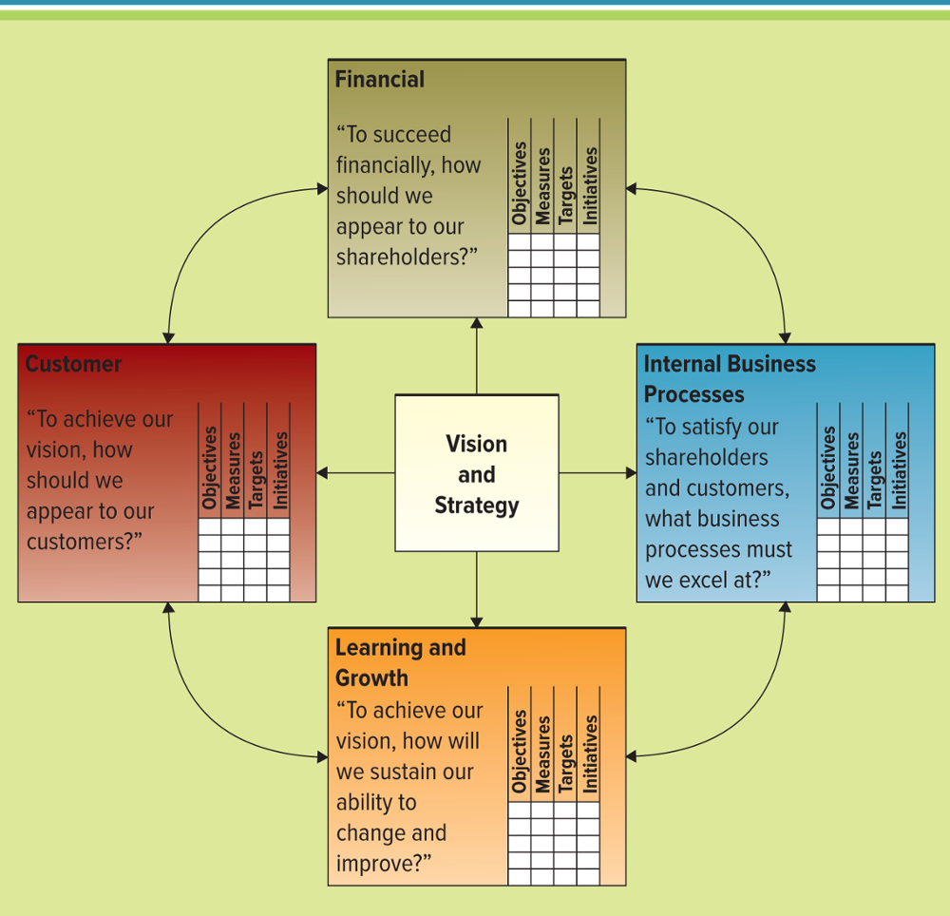
Figure 8.38 The Four Primary Perspectives of the Balanced Scorecard (1992 Kaplan&Norton)
Jump to long image description
Notes:
The balanced scorecard is a management system, (in addition to a measurement system), that enables organizations to clarify their vision and strategy and translate them into action. It provides feedback around both the internal business processes and external outcomes in order to continuously improve strategic performance and results. When fully deployed, the balanced scorecard transforms strategic planning from an academic exercise into the nerve center of an enterprise
The balanced scorecard views the organization from four perspectives, and users should develop metrics, collect data, and analyze their business relative to each of these perspectives:
The learning and growth perspective.
The internal business process perspective.
The customer perspective.
The financial perspective.

Slide 61
策略性現況診斷—水平缺口分析表
 | 理想性平衡計分卡 vs. 現階段策略執行狀況 (水平缺口分析)
 | 策略性議題 |  |  | 策略性目標
 | 理想 |  | 現況 | 理想 |  | 現況
財務 | FA | 營收成長 | 營收成長 | FA1 | 提昇新產品(產品組合、產業價位)之營收 | 缺口
 |  |  |  | FA2 | 舊產品在新市場或新客戶擴張 | 缺口
 |  |  |  | FA3 | 新產品出口(歐美日) | 缺口
顧客 | CA | 全面性的技術及解決方案之服務領導 | 缺口 | CA1 | 滿足客戶一次購足之需求 | 缺口
 |  |  |  | CA2 | 全面性之客戶問題解決及關係維繫 | 全面性的客戶問題解決及關係維繫
內部程序 | IA | 全面性的解決方案服務管理 | 全面性的解決方案服務管理 | IA11 | 產品組合管理 | 產品組合管理
 |  |  |  | IA12 | 應用配方及技術之整合服務管理(諮詢，研發) | 缺口
 |  |  |  | IA21 | 外部技術合作之管理 | 缺口
 |  |  |  | IA22 | 顧客關係維繫管理 | 缺口
學習成長 | LA | 全面性的解決方案服務能力 | 缺口 | LAP11 | 培養產品研發人才 | 培養產品研發人才
 |  |  |  | LAP12 | 產品應用研發組合能力 | 缺口
 |  |  |  | LAP21 | 與外部技術顧問及團隊合作 | 缺口
 |  |  |  | LAP22 | DATABANK(產品的基本面與應用面) | 缺口
（出處：本研究）

Slide 62
策略性衡量指標之目標值表
（出處：本研究）

Slide 63
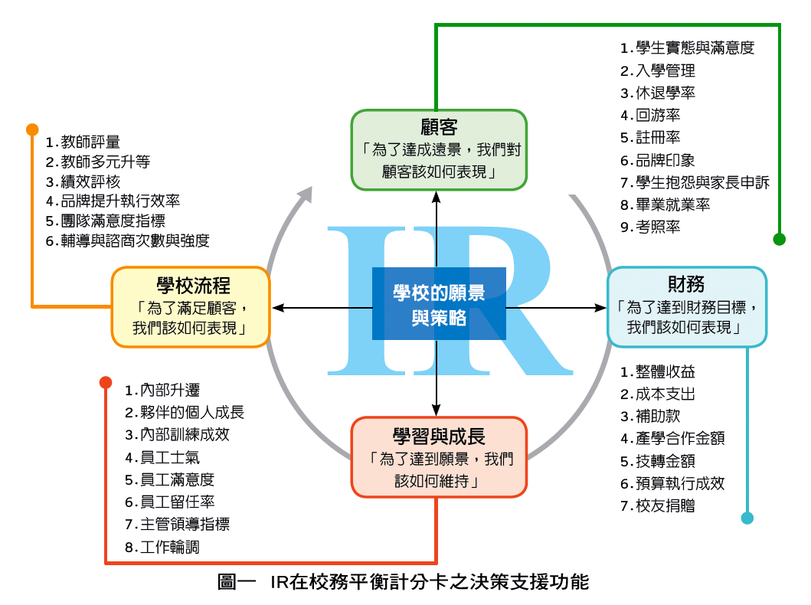

Slide 64
Organizational Integration with ERP
SCM, CRM, and ERP are the backbone of ebusiness
Integration of these applications is the key to success for many companies
Integration allows the unlocking of information to make it available to any user, anywhere, anytime
Safeway提供自己的產品，例如Safeway的意大利麵條醬和Safeway的紙巾（這些被稱為名牌產品，通常具有成本優勢）
該商店還提供特定於製造商的產品，如Ragu的意大利麵醬和Bounty的紙巾
客戶可以選擇購買Safeway的產品（這類似於ERP提供的產品），或者客戶可以選擇購買通常更貴但提供更好質量，附加功能和更好口味的特殊產品（例如Ragu）
ERP供應商帶有SCM和CRM module，但他們通常不如專注於SCM和CRM的供應商（Siebel CRM，i2 SCM）
Notes:
It might be a bit confusing to your student that many ERP vendors offer SCM and CRM components
Explain to your students that these modules are typically not as functional or flexible as the modules offered by industry leaders who specialize in SCM and CRM
A good analogy is to brand-name foods at a grocery store
A grocery store, such as Safeway, maintains all types of products
Safeway offers its own products, such as Safeway’s spaghetti sauce and Safeway’s paper towels, (these are known as name brand products and usually offer a cost advantage)
The store also carries products that are specific to a manufacturer, such as Ragu’s spaghetti sauce and Bounty’s paper towels
Customers can choose to buy Safeway’s product (this is similar to product supplied by the ERP), or customers can choose to buy a specialty product that is usually more expensive but offers better quality, additional features, and better taste (such as Ragu)
Explain to your students that ERP vendors carry SCM and CRM components, but they are usually not as good as the vendors that specialize in SCM and CRM components (Siebel CRM, i2 SCM)

Slide 65
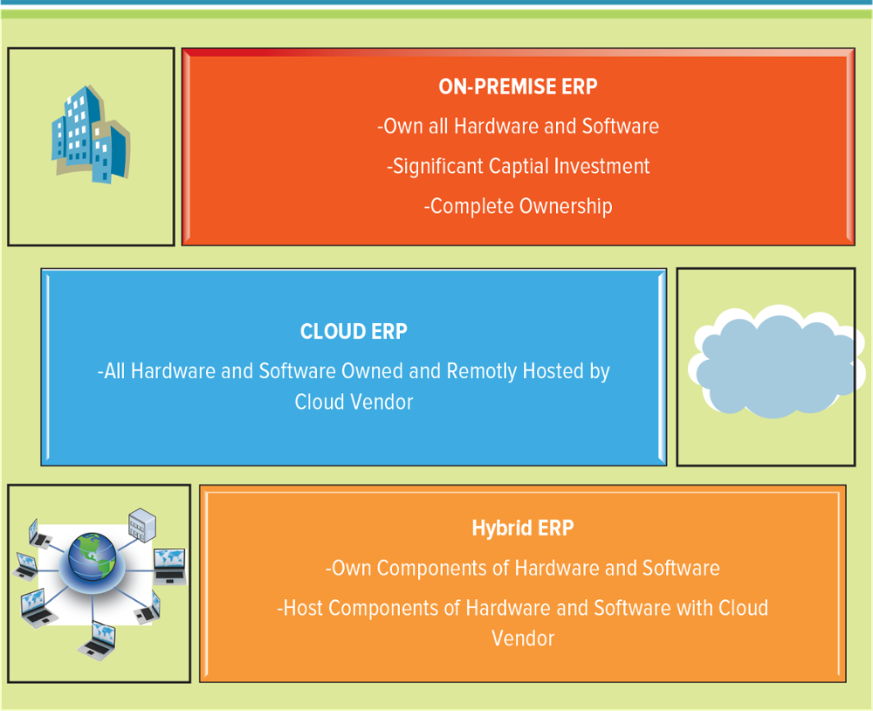
Figure 8.39 ERP Implementation Choices
The three primary ERP implementation choices driving the next generation of business operations
預置

Slide 66
On-Premise ERP
On-premise systems – Include a server at a physical location using an internal network for internal access and firewalls for remote users’ access
Legacy system – An old system that is fast approaching or beyond the end of its useful life within an organization

Slide 67
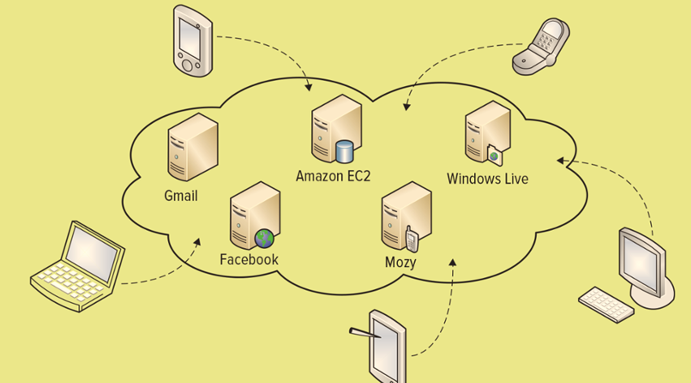
Figure 8.40 Cloud Computing Example
Cloud computing offers new ways to store, access, process, and analyze information and connect people and resources from any location in the world where an Internet connection is available
Jump to long image description

Slide 68
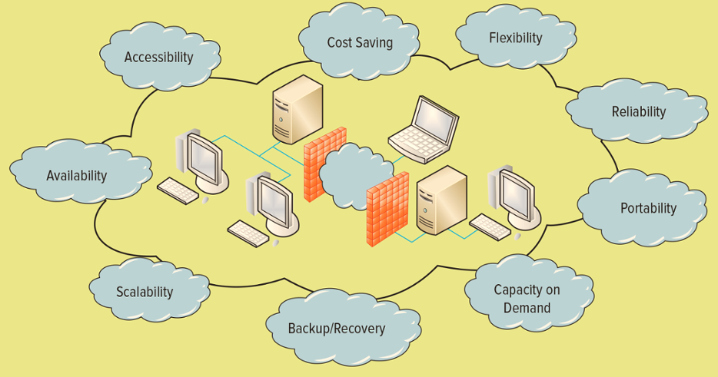
Figure 8.41 Advantages of SaaS Implementations
Jump to long image description

Slide 69
Hybrid ERP
Hybrid ERP – Splits the ERP functions between an on-premises ERP system and one or more functions handled as Software as a Service in the cloud
Scenarios common in hybrid architectures of ERP:
A business with a very specific local focus, such as single-site or multisite within a single country or region
A business with operations geared strongly toward a specific industry
A newly acquired operation with a mismatch of multiple outdated, unsupported ERPs
A small company with no formal ERP in place
Notes:
The idea behind hybrid ERP is to split the ERP functions between an on-premises ERP system and one or more functions handled as Software as a Service in the cloud.
Typically, the on-premise legacy application operates at the corporate headquarters, whereas cloud-based specific applications support business needs such as mobility and web-based functionality. It is also becoming increasingly popular. In fact, many analysts are predicting that hybrid ERP will become a mainstay in the ERP market in the next few years.

Slide 70
Hybrid ERP
Typically, the on-premise legacy application operates at the corporate headquarters,
whereas cloud-based specific applications support business needs such as mobility and web-based functionality.
It is also becoming increasingly popular.
In fact, many analysts are predicting that hybrid ERP will become a mainstay in the ERP market in the next few years.

Slide 71
Learning Outcome Review
Now that you have finished the chapter please review the learning outcomes in your text.

Slide 72
Appendix of Image Long Descriptions

Slide 73
Appendix 1 Figure 8.2 A Forward and Backward Customer Information Integration Example
The four systems in the example include: sales, order entry, order fulfillment, and billing.
Each system contains information for Craig Schultz.
Forward integration of customer information flows in links from sales to order entry to order fulfillment to billing.
Backward integration flows in reverse links from billing to order fulfillment to order entry to sales.
Return to original slide

Slide 74
Appendix 2 Figure 8.3 Integrating Customer Information Among Databases
Information flows from a central customer information system out to four separate systems: order entry, sales, billing, and order fulfillment.
Each system contains information for Craig Schultz.
Return to original slide

Slide 75
Appendix 3 Figure 8.5 The Five Basic Supply Chain Activities
Plan – Prepare to manage all resources required to meet demand.
Source – Build relationships with suppliers to procure raw materials.
Make – Manufacture products and create production schedules.
Deliver – Plan for transportation of goods to customers.
Return – Support customers and product returns.
Return to original slide

Slide 76
Appendix 4 Figure 8.6 A Typical Supply Chain
Key entities from left to right are: supplier, manufacturer, distributor, retailer, and customer.
Entities form a chain with bidirectional links between neighbors.
On the far left, three entities labeled supplier's supplier connect bi-directionally to supplier.
On the far right, three entities labeled customers' customer connect bi-directionally to customer.
Links moving through the chain from supplier to customer are noted as downstream.
Links moving from customer to supplier are noted as upstream.
Return to original slide

Slide 77
Appendix 5 Figure 8.7 Supply Chain for a Bike Manufacturer
Chain is shown as:
Manufacturers of aluminum, tires, brakes, accessories, and packaging flow into raw materials storage.
Raw materials storage then flows to bike production, which flows to distribution of finished bikes to retailers Individual retailers then sell the bikes to customers.
Return to original slide

Slide 78
Appendix 6 Figure 8.8 Supply Chain for a Product Purchased from Walmart
All links between entities in the chain are bidirectional and indicate information flows for products, pricing, scheduling, and availability.
Chain is shown as:
A paper manufacturer links to a packaging supplier which links to multiple Procter and Gamble manufacturing centers.
Procter and Gamble instances link to a single cocoa oil and a single scented oil manufacturer.
Procter and Gamble instances also link to multiple Walmart Warehouses or Distributors, which then link to multiple Walmart Stores, and finally to Customers.
Return to original slide

Slide 79
Appendix 7 Figure 8.9 Effective and Efficient Supply Chain Management’s Effect on Porter’s Five Forces
An organization's supply chain decreases buyer power, threat of substitute products or services, and threat of new entrants.
An organization’s supply chain increases supplier power.
Return to original slide

Slide 80
Appendix 8 Figure 8.10 Supply Chain Planning’s and Supply Chain Execution’s Roles in the Supply Chain
Key entities from left to right are: supplier, manufacturer, distributor, retailer, and customer.
Entities form a chain with bidirectional links between neighbors.
Supply chain execution is concerned with the flow from supplier through the chain to customer.
Supply chain planning is concerned with the flow from customer through to supplier.
Return to original slide

Slide 81
Appendix 9 Figure 8.11 The Three Business Areas of Supply Chain Management
Each area feeds into supply chain management:
Procurement – Purchasing of goods and services to meet the needs of the supply chain.
Logistics – Processes that control the distribution, maintenance, and replacement of materials and personnel to support the supply chain.
Materials management – Activities that govern the flow of tangible, physical materials through the supply chain such as shipping, transport, distribution, and warehousing.
Return to original slide

Slide 82
Appendix 10 Figure 8.12 Disruptive Business Technologies
3 D printing
A process that builds, layer by layer in an additive process, a three-dimensional solid object from a digital model
Supports procurement
R F I D
Uses electronic tags and labels to identify objects wirelessly over short distances
Supports logistics
Drones
Unmanned aircraft that can fly autonomously, or without a human
Supports logistics
Robotics
Focus on creating artificial intelligence devices that can move and react to sensory input
Supports materials management
Return to original slide

Slide 83
Appendix 11 Figure 8.16 Customer Relationship Management Key Players
Lead – A person or company that is unknown to your business.
Account – An existing business relationship exists and can include customers, prospects, partners, and competitors.
Contact – Specific individual representing the account.
Sales opportunity – An opportunity exists for a potential sale of goods or services related to an account or contact.
Return to original slide

Slide 84
Appendix 12 Figure 8.18 Customer Relationship Management Overview
Customer information flows bi-directionally with a company through online, phone, service counter, or register line contact.
Within the company, information flows into four systems: accounting, order fulfillment, inventory, and customer service.
These systems all relate bi-directionally to a single customer relationship management system.
Return to original slide

Slide 85
Appendix 13 Figure 8.19 Evolution of CRM
Reporting – Customer identification: Asking what happened
What is the total revenue by customer?
How many units did we make?
What were total sales by product?
What are the current inventory levels?
Analyzing – Customer segmentation: Asking why it happened
Why did sales not meet forecasts?
Why was production so low?
Why did we not sell as many units as previous years?
Who are our customers?
Why was revenue so high?
Why are inventory levels low?
Predicting – Customer prediction: Asking what will happen
What customers are at risk of leaving?
Which products will our customers buy?
Who are the best customers for a marketing campaign?
How do we reach our customers?
What will sales be this year?
How much inventory do we need to preorder?
Return to original slide

Slide 86
Appendix 14 Figure 8.22 Operational CRM and Analytical CRM
A front office, operational C R M has three systems: sales, marketing, and customer service.
Each front office system flows into a data warehouse contained within a back office, analytical C R M.
The data warehouse has a bidirectional link to a data mining entity also within the back office C R M and an independent collaborative C R M system.
Return to original slide

Slide 87
Appendix 15 Figure 8.23 Operational CRM Technologies
Marketing technology includes:
List generator
Campaign management
Cross-selling and up-selling
Sales technology includes:
Sales management
Contact management
Opportunity management
Customer service technology includes:
Contact center
Web-based self-service
Call scripting
Return to original slide

Slide 88
Appendix 16 Figure 8.24 A Typical Sales Process
An opportunity is generated with a lead sent to a salesperson.
A potential customer is then contacted leading to a potential customer meeting.
Problems and solution are identified next, leading to generation of a customer sales quote.
A sales order is then placed which leads to order fulfillment.
Finally, the customer is billed.
Return to original slide

Slide 89
Appendix 17 Figure 8.29 Enterprise Resource Planning System Overview
Corporate data on employees, orders, customers, sales, and inventory all feed into an E R P.
The E R P provides global reports on sales, manufacturing, and shipping.
Return to original slide

Slide 90
Appendix 18 Figure 8.31 ERP Process Flow
Sales, warehouse, accounting, and receiving entities are shown, each with internal processes. Each entity has a bi-directional link to a central information element.
Within sales, a sales quote process leads to a sales order process.
The sales order leads to a pack and ship process within the warehouse.
Pack and ship leads to a billing process within accounting followed by a payment process.
The payment process leads to a returns process within receiving.
Return to original slide

Slide 91
Appendix 19 Figure 8.32 The Organization before and after ERP 1 of 2
The organization before E R P is represented by an office floor plan that highlights the location of various information sources. Each source is shown as a separate entity and entities are distributed throughout the floor.
Information sources include: document management, work flow, E R P, sales, logistics, financials, H R, portal and website, and project management.
Return to original slide

Slide 92
Appendix 20 Figure 8.32 The Organization before and after ERP 2 of 2
The organization after E R P is represented by an office floor plan which now shows only a single information source entity, central to the entire floor.
Information within the single source includes: document management, work flow, E R P, sales, logistics, financials, H R, portal and website, and project management.
Return to original slide

Slide 93
Appendix 21 Figure 8.33 The Evolution of ERP
ERP (year 1990)
Materials planning
Order entry
Distribution
General ledger
Accounting
Shop floor control
Extended E R P –(year 2000)
Scheduling
Forecasting
Capacity planning
Ecommerce
Warehousing
Logistics
E R P – II (present time)
Project management
Knowledge management
Work flow management
Customer relationship management
Human resources management
Portal capability
Integrated financials
Return to original slide

Slide 94
Appendix 22 Figure 8.35 Core ERP Components and Extended ERP Components
Core E R P components include: accounting and finance; production and materials management; and human resources.
Extended E R P components include: business intelligence, customer relationship management, supply chain management, and ebusiness.
All core and extended components feed into common enterprise resource planning software.
Return to original slide

Slide 95
Appendix 23 Figure 8.38 The Four Primary Perspectives of the Balanced Scorecard
Vision and strategy is at the center, surrounded by perspectives and pertinent questions about the perspective:
Financial – to succeed financially, how should we appear to our shareholders
Internal business processes – to satisfy our shareholders and customers, what business processes must we excel at?
Learning and growth – to achieve our vision, how will we sustain our ability to change and improve?
Customer – to achieve our vision, how should we appear to our customers?
Each perspective includes considerations for objectives, measures, targets, and initiatives.
Perspectives create a continuous loop with two-way flow between neighboring perspectives.
Return to original slide

Slide 96
Appendix 24 Figure 8.39 ERP Implementation Choices
On-premise E R P
Own all hardware and software
Significant capital investment
Complete ownership
Cloud E R P
All hardware and software owned and remotely hosted by cloud vendor
Hybrid E R P
Own components of hardware and software
Host components of hardware and software with cloud vendor
Return to original slide

Slide 97
Appendix 25 Figure 8.40 Cloud Computing Example
A cloud-shaped outline contains computing systems providing applications including: Windows Live, Mozy, Facebook, Gmail, and Amazon E C 2.
Various devices, such as a laptop, tablet, cell phones, and desktop computer each connect into the cloud.
Return to original slide

Slide 98
Appendix 26 Figure 8.41 Advantages of SaaS Implementations
advantages include: accessibility, cost saving, flexibility, reliability, portability, capacity on demand, backup/recovery, scalability, availability.
Return to original slide

